Slide 1
Shiny-1

Slide 2
What is Shiny?
Shiny is an R package that allows you to easily create rich, interactive web apps. Shiny allows you to take your work in R and expose it via a web browser so that anyone can use it. Shiny makes you look awesome by making it easy to produce polished web apps with a minimum amount of pain.
In the past, creating web apps was hard for most R users because:
You need a deep knowledge of web technologies like HTML, CSS and JavaScript.
Making complex interactive apps requires careful analysis of interaction flows to make sure that when an input changes, only the related outputs are updated.
Shiny makes it significantly easier for the R programmer to create web apps by:
Providing a carefully curated set of user interface (UI for short) functions that generate the HTML, CSS, and JavaScript that you need for common tasks. This means that you don’t need to know the details of HTML/CSS/JS until you want to go beyond the basics that Shiny provides for you.
Introducing a new style of programming called reactive programming which automatically tracks the dependencies of a code chunk. This means that whenever an input changes, Shiny can automatically figure out how to do the smallest amount of work to update all the related outputs.

Slide 3
Your first Shiny app
Basic UI
Basic reactivity
The server function
Input
Output
Reactive programming
Reactive expressions
The motivation
The app
The reactive graph
Simplifying the graph
Controlling timing of evaluation
Timed invalidation
On click
Graphics
Ineractivity
Basics
Clicking
Brushing
Dynamic height and width
Your first Shiny app
Create app directory and file
Adding UI controls
Adding behavior
Basic UI
Inputs
Free text
Numeric inputs
Dates
Limited choices
File uploads
Action buttons
Outputs
Text
Tables
Plots
Layouts
Page with sidebar
Multi-row
Themes

Slide 4
1)Your first Shiny app
UI (short for user interface) - defines how your app looks
server function - defines how your app works
Shiny uses reactive programming to automatically update outputs when inputs change so we’ll finish off the chapter by learning the third important component of Shiny apps: reactive expressions.
There are several ways to create a Shiny app. The simplest is to create a new directory for your app, and put a single file called app.R in it. This app.R file will be used to tell Shiny both how your app should look, and how it should behave.

Slide 5
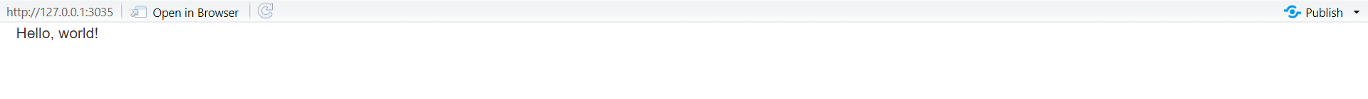
1.1)Create app directory and file
It calls library(shiny) to load the shiny package.
It defines the user interface, the HTML webpage that humans interact with. In this case, it’s a page containing the words “Hello, world!”.
It specifies the behavior of our app by defining a server function. It’s currently empty, so our app doesn’t do anything, but we’ll be back to revisit this shortly.
It executes shinyApp(ui, server) to construct and start a Shiny application from UI and server.
Next, we’ll add some inputs and outputs to our UI so it’s not quite so minimal. We’re going to make a very simple app that shows you all the built-in data frames included in the datasets package.

Slide 6
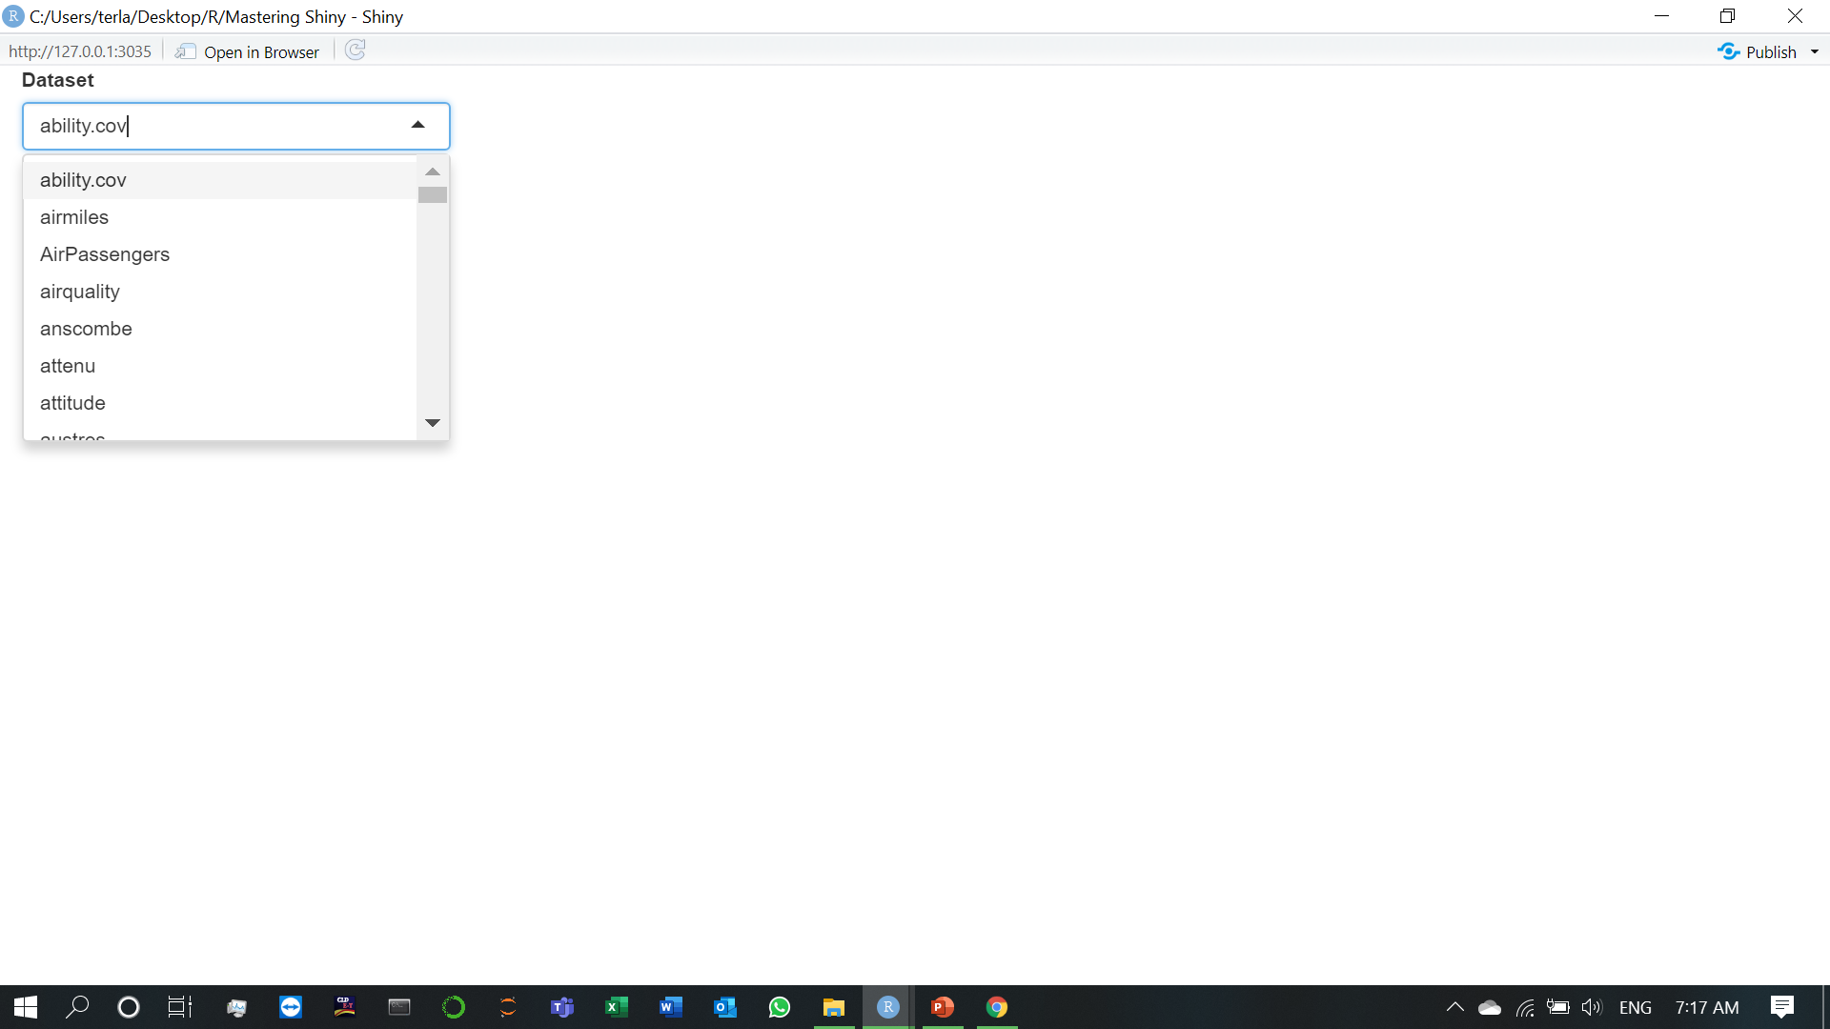
1.2)Adding UI controls

Slide 7
fluidPage() is a layout function that sets up the basic visual structure of the page.
selectInput() is an input control that lets the user interact with the app by providing a value. In this case, it’s a select box with the label “Dataset” and lets you choose one of the built-in datasets that come with R.
verbatimTextOutput() and tableOutput() are output controls that tell Shiny where to put rendered output (we’ll get into the how in a moment). verbatimTextOutput() displays code and tableOutput displays tables.
Next, we’ll bring the outputs to life by defining them in the server function.
In this simple case, we’re going to tell Shiny how to fill in the summary and table outputs—we’re providing the “recipes” for those outputs.

Slide 8
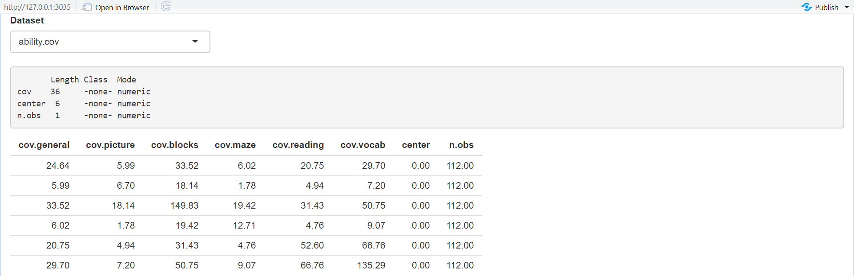
1.3)Adding behavior
Notice that I haven’t written any code that checks for changes to input$dataset and explicitly updates the two outputs. That’s because outputs are reactive: they automatically recalculate when their inputs change. Because both of the rendering code blocks I wrote used input$dataset, whenever the value of input$dataset changes (i.e. the user changes their selection in the UI), both outputs will recalculate and update in the browser.

Slide 9
2)Basic UI
As you saw in the previous chapter, Shiny encourages separation of the code that generates your user interface (the front end) from the code that drives your app’s behaviour (the backend). In this chapter, we’ll dive deeper into the front end and explore the HTML inputs, outputs, and layouts provided by Shiny.
In the next chapter, you’ll learn more about the reactivity that powers Shiny’s backend, allowing you to create richer responses to interaction.
As we saw in the previous chapter, you use functions like sliderInput(), selectInput(), textInput(), and numericInput() to insert input controls into your UI specification. The following sections describe the inputs built into Shiny, loosely grouped according to the type of control they create. The goal is to give you a rapid overview of your options, not to exhaustively describe all the arguments. I’ll show the most important parameters for each control below, but you’ll need to read the documentation to get the full details.

Slide 10
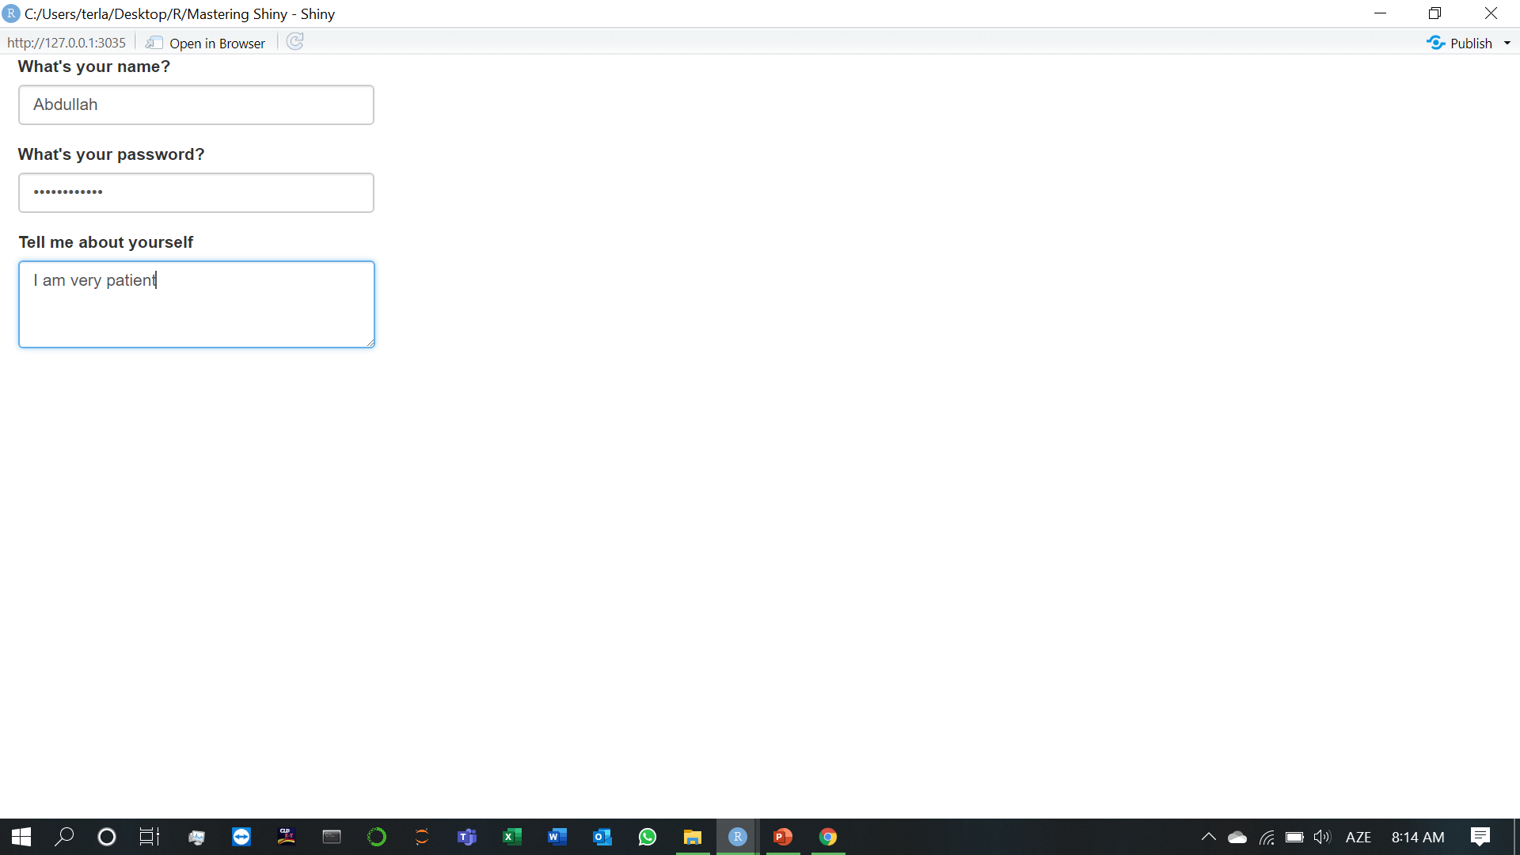
2.1)Inputs (1.Free text)

Slide 11
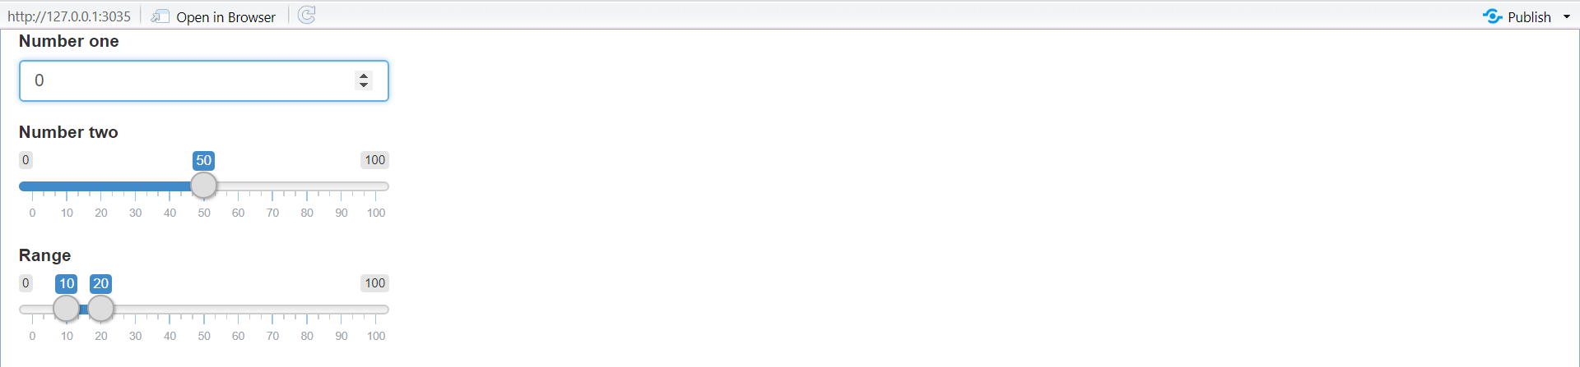
2.1) Inputs (2.Numeric inputs)
Generally, I recommend only using sliders for small ranges, or cases where the precise value is not so important. Attempting to precisely select a number on a small slider is an exercise in frustration!
Sliders are extremely customisable and there are many ways to tweak their appearance.
See ?sliderInput and https://shiny.rstudio.com/articles/sliders.html for more details.

Slide 12
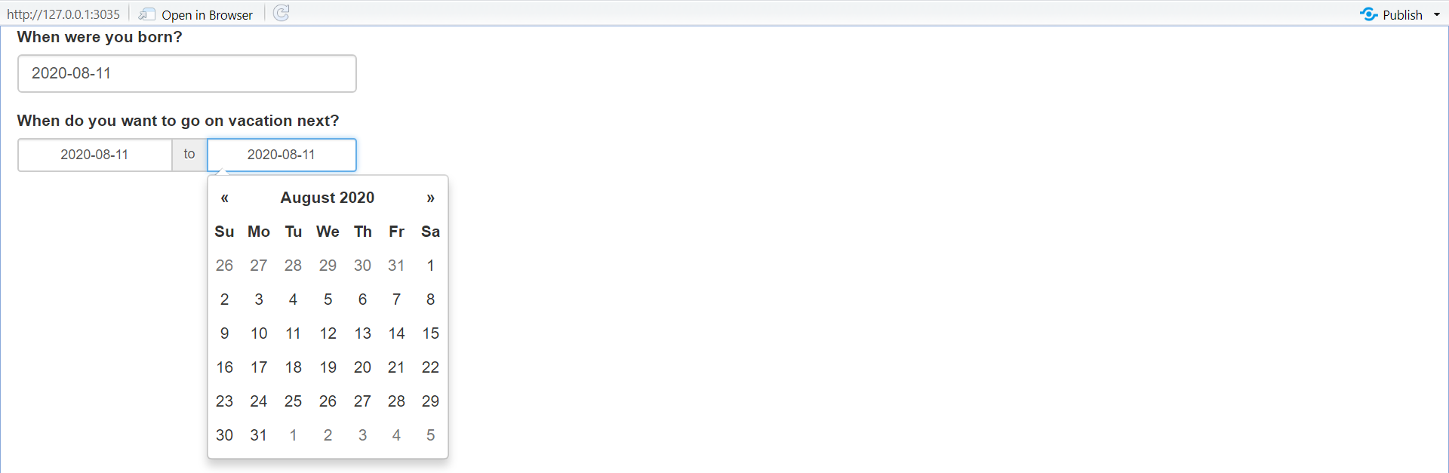
2.1) Inputs (3.Dates)
Collect a single day with dateInput() or a range of two days with dateRangeInput(). These provide a convenient calendar picker, and additional arguments like datesdisabled and daysofweekdisabled allow you to restrict the set of valid inputs.

Slide 13
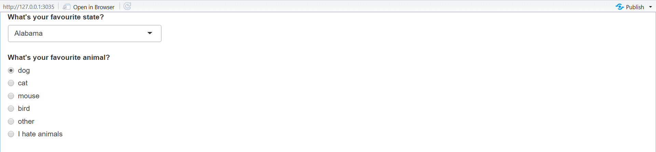
2.1) Inputs (4.Limited choices)
There are two different approaches to allow the user to choose from a prespecified set of options: selectInput() and radioButtons().

Slide 14
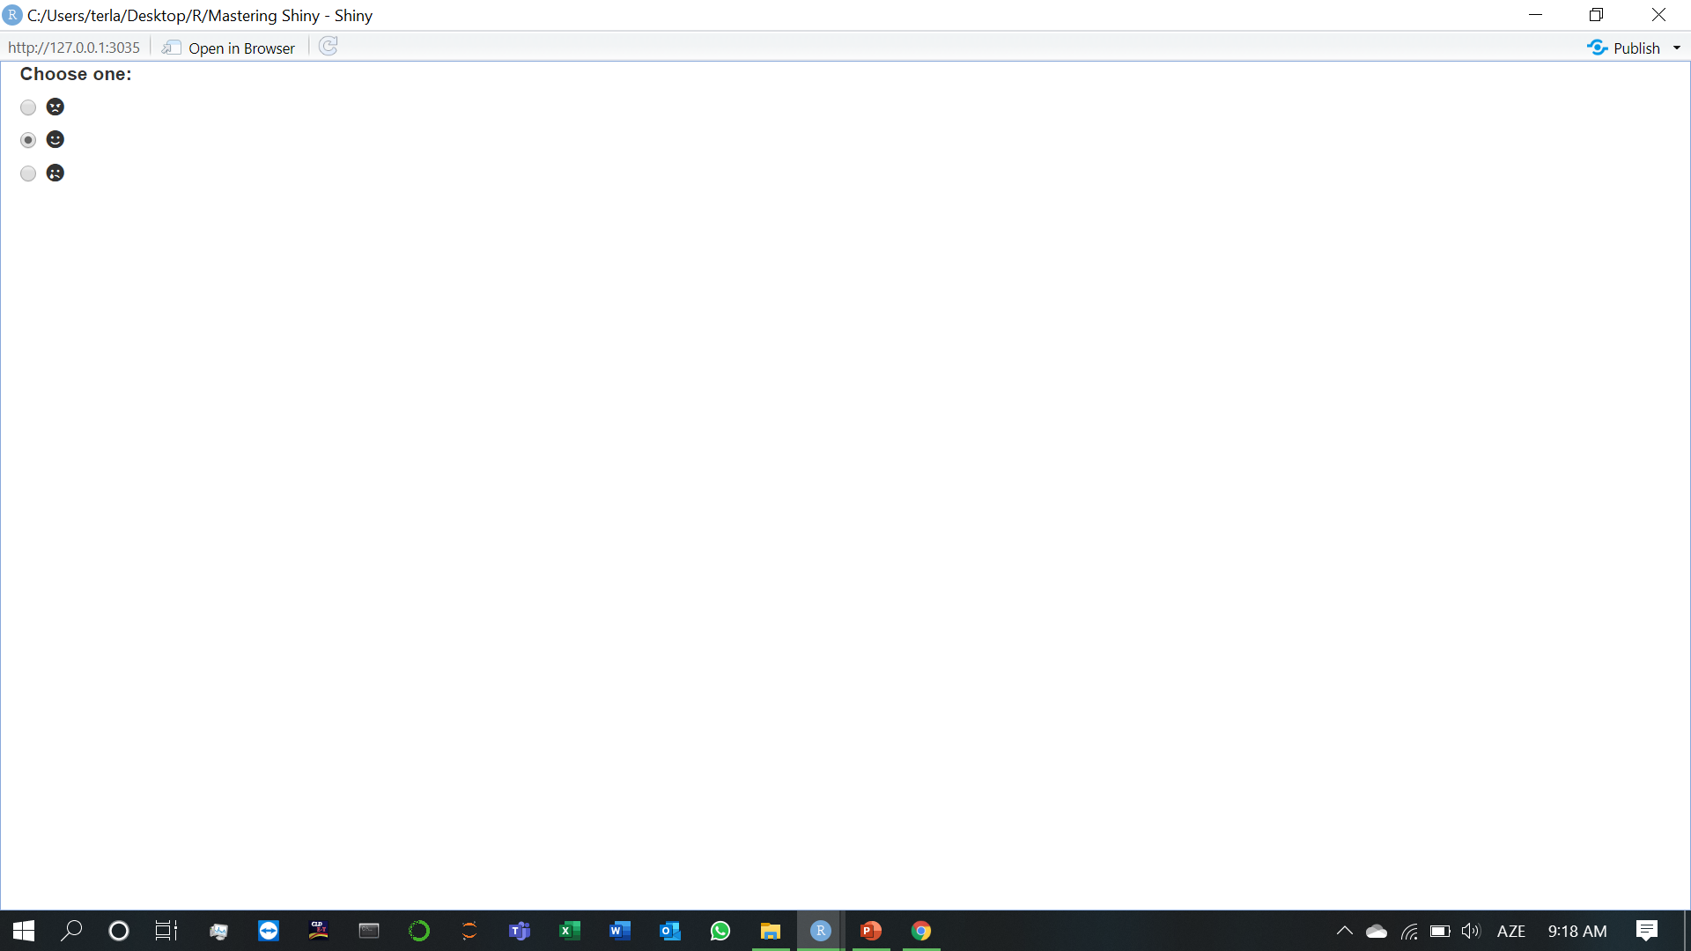
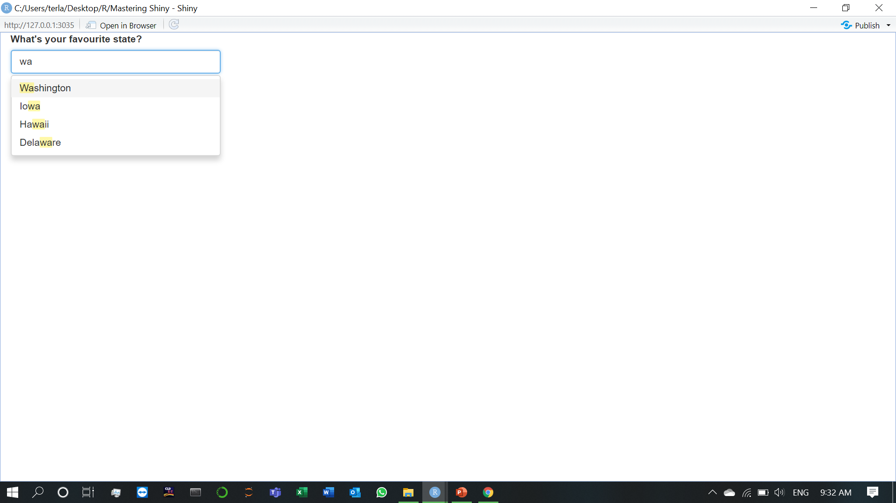
Radio buttons have two nice features: they show all possible options, making them suitable for short lists, and via the choiceNames / choiceValues arguments, they can display options other than plain text.
Dropdowns created with selectInput() take up the same amount of space, regardless of the number of options, making them more suitable for longer options. You can also set multiple=TRUE to allow the user to select multiple elements.

Slide 15
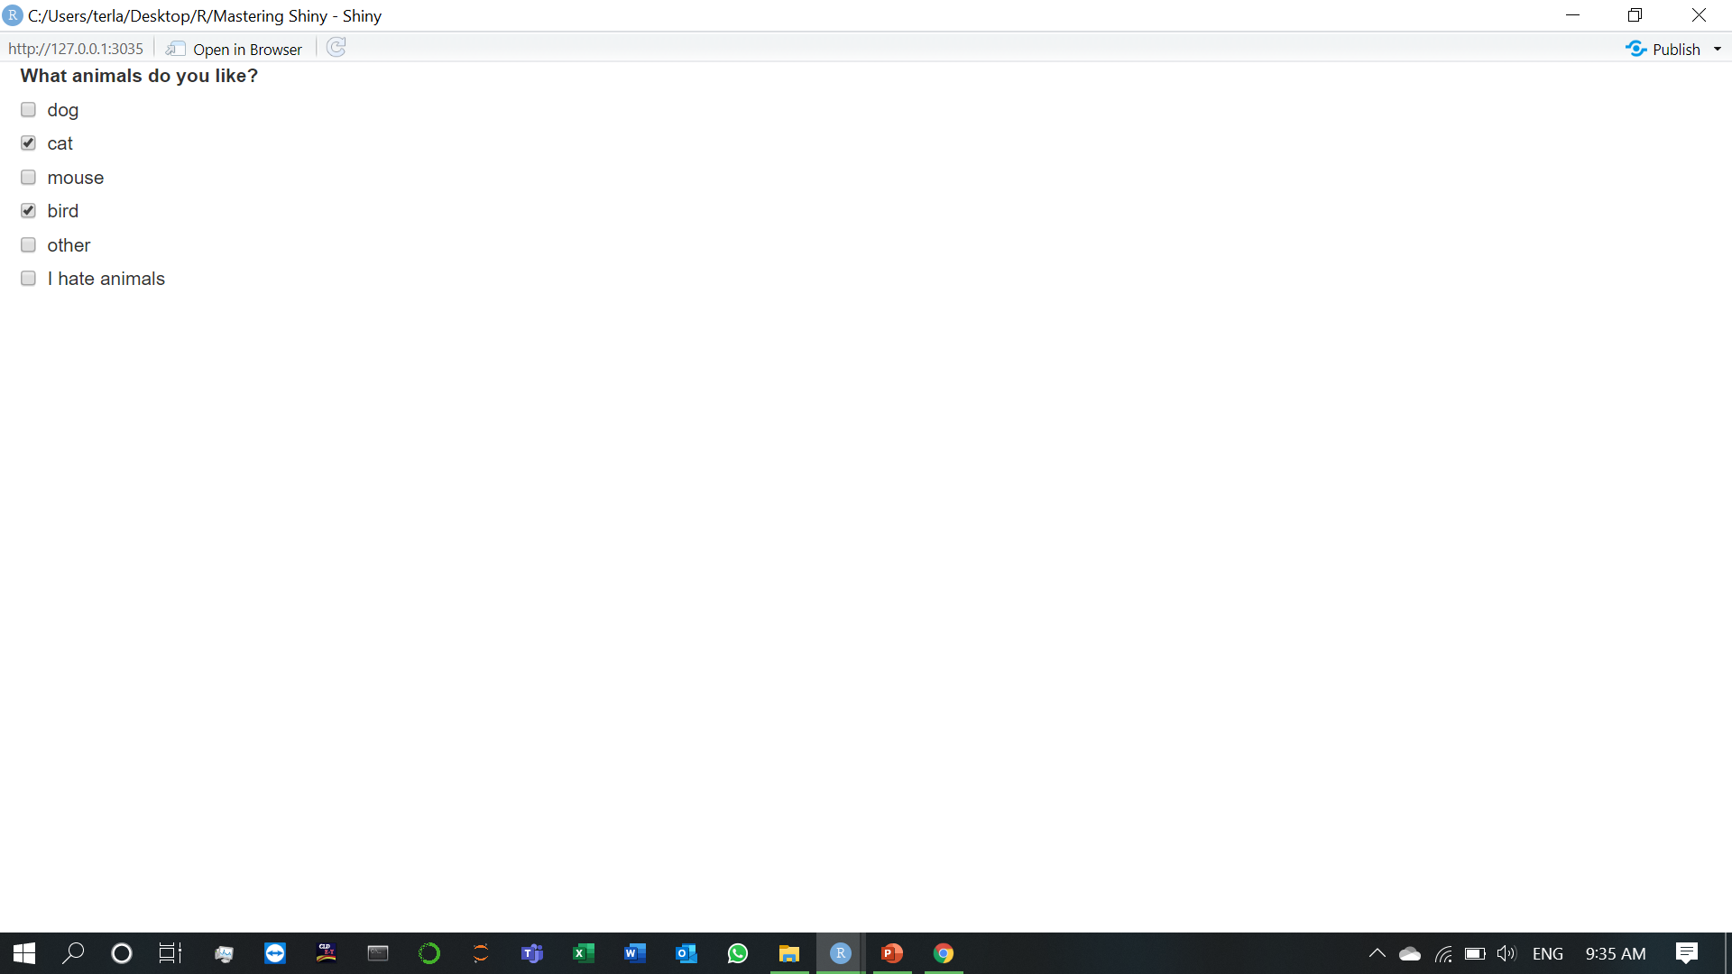
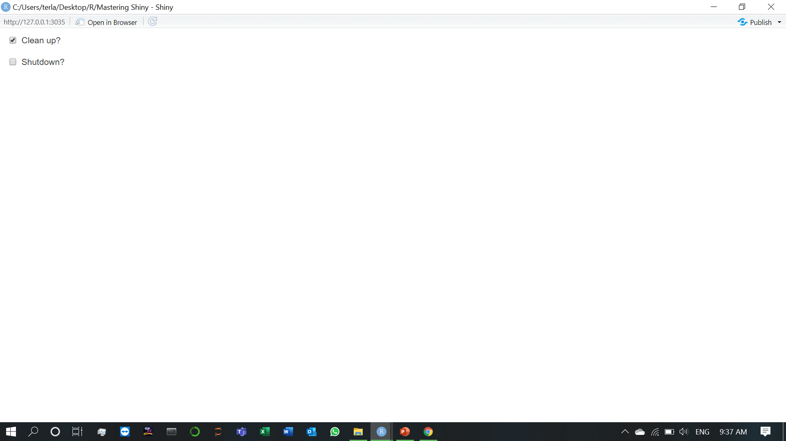
There’s no way to select multiple values with radio buttons, but there’s an alternative that’s conceptually similar: checkboxGroupInput().
If you want a single checkbox for a single yes/no question, use checkboxInput():

Slide 16
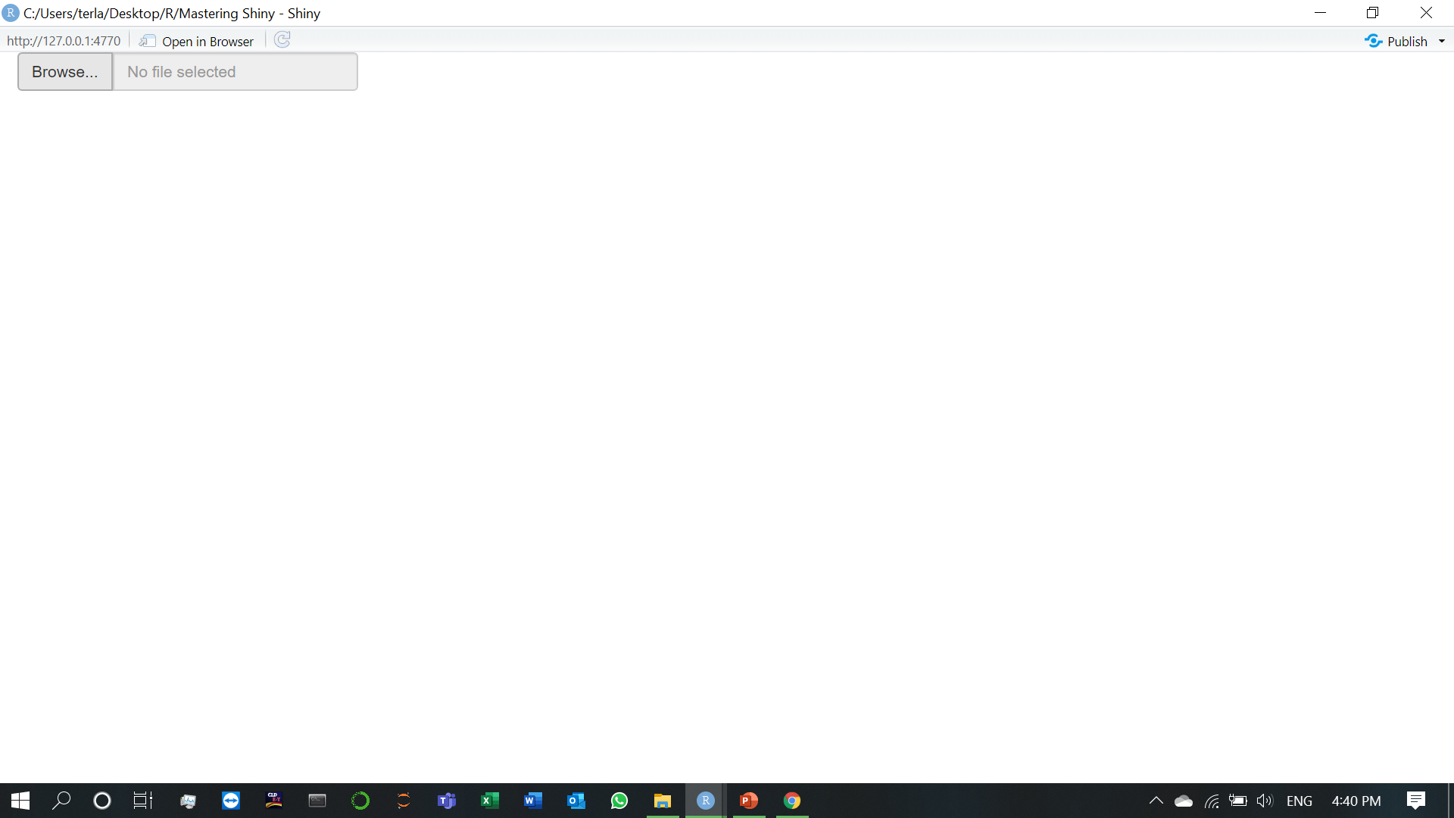
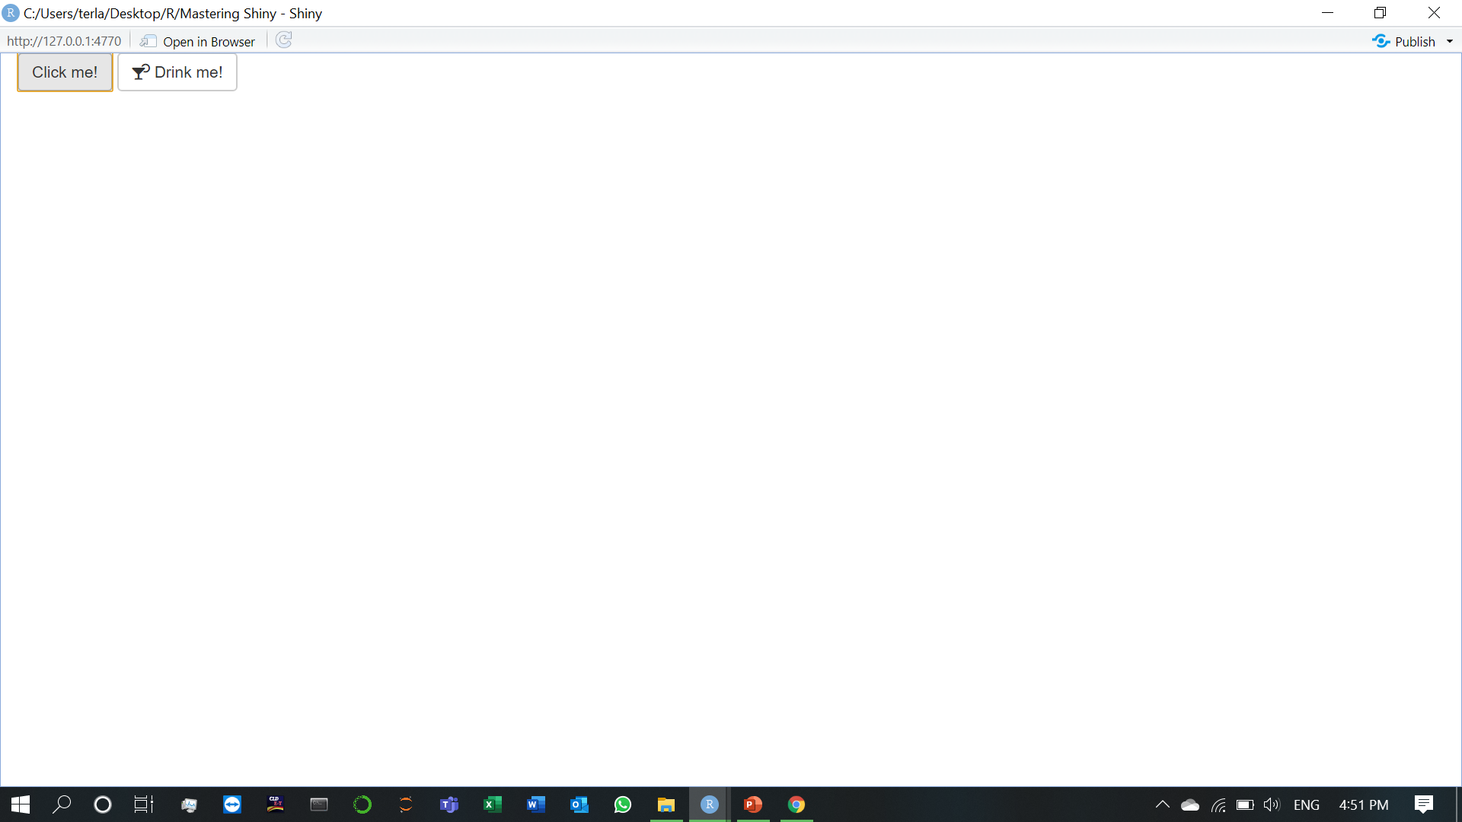
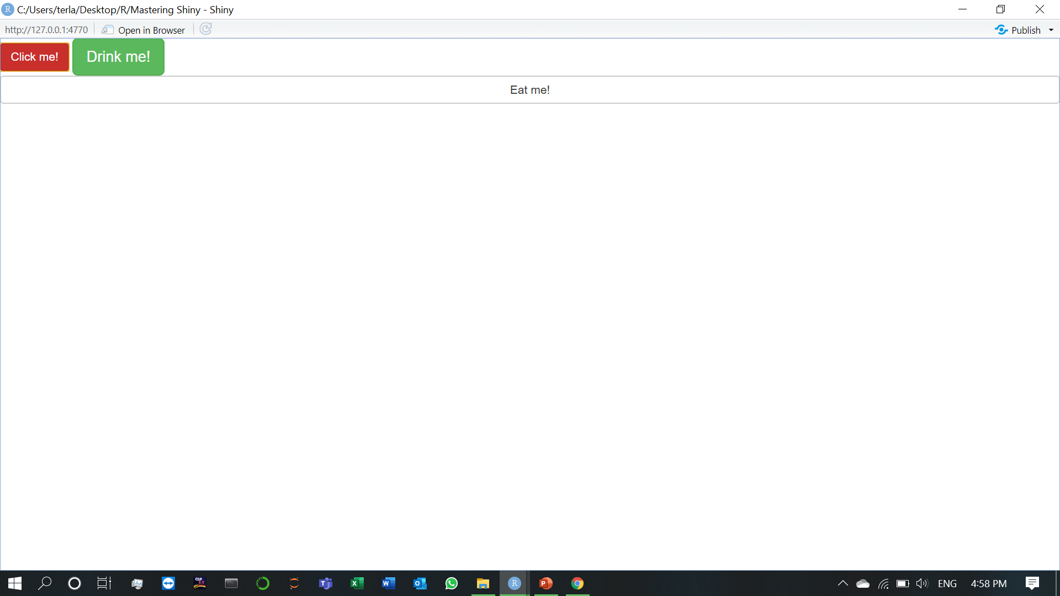
2.1) Inputs (5.File uploads)
2.1) Inputs (6.Action buttons)
You can customise the appearance using the class argument by using one of "btn-primary", "btn-success", "btn-info", "btn-warning", or "btn-danger". You can also change the size with "btn-lg", "btn-sm", "btn-xs". Finally, you can make buttons span the entire width of the element they are embedded within using "btn-block". See the detail of the underlying CSS classes at http://bootstrapdocs.com/v3.3.6/docs/css/#buttons.

Slide 17
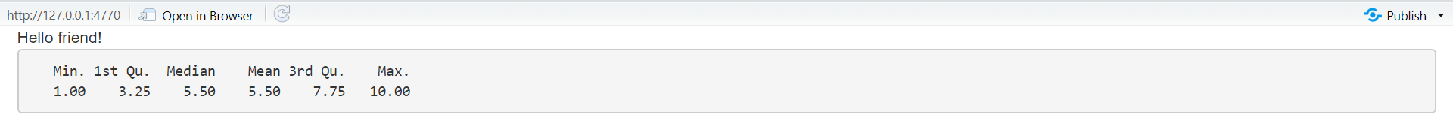
2.2) Outputs
Outputs in the UI create placeholders that are later filled by the server function. Like inputs, outputs take a unique ID as their first argument: if your UI specification creates an output with ID "plot", you’ll access it in the server function with output$plot.
Each output function on the front end is coupled with a render function in the back end. There are three main types of output, corresponding to the three things you usually include in a report: text, tables, and plots. The following sections show you the basics of the output functions on the front end, along with the corresponding render functions in the back end.
2.2) Outputs (1.Text)
Output regular text with textOutput() and fixed code and console output with verbatimTextOutput().
renderText() combines the result into a single string.
renderPrint() prints the result.

Slide 18
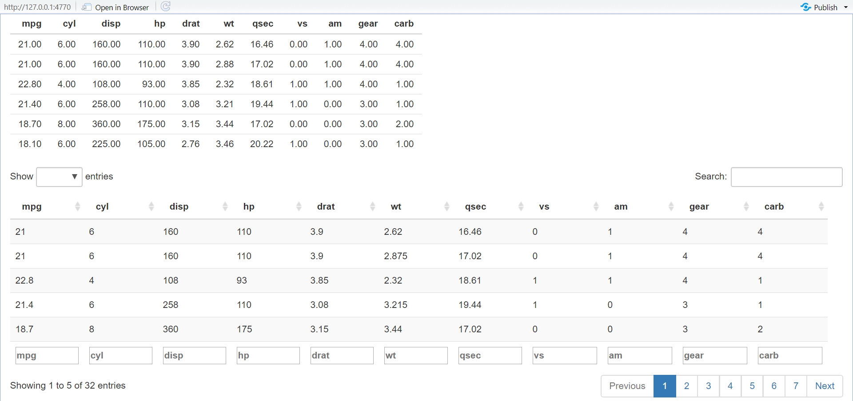
2.2) Outputs (2.Tables)

Slide 19
There are two options for displaying data frames in tables:
tableOutput() and renderTable() render a static table of data, showing all the data at once.
dataTableOutput() and renderDataTable() render a dynamic table, showing a fixed number of rows along with controls to change which rows are visible.
tableOutput() is most useful for small, fixed summaries (e.g. model coefficients);
dataTableOutput() is most appropriate if you want to expose a complete data frame to the user.

Slide 20
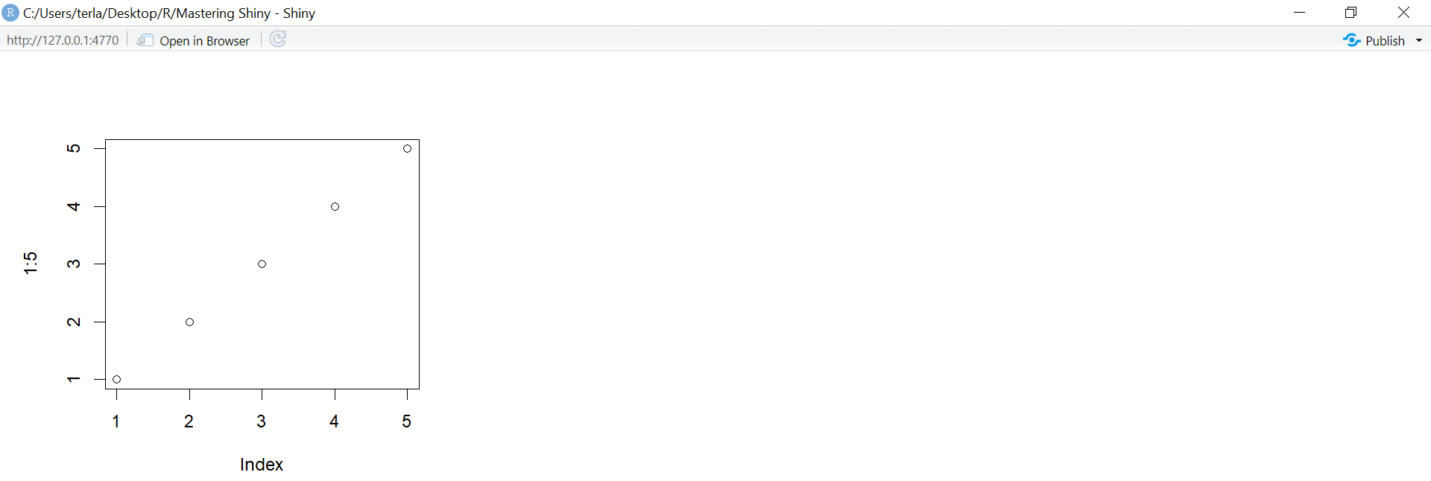
2.2) Outputs (3.Plots)
By default, plotOutput() will take up the full width of its container (more on that shortly), and will be 400 pixels high. You can override these defaults with the height and width arguments. We recommend always setting res=96 as that will make your Shiny plots match what you see in RStudio as closely as possible.

Slide 21
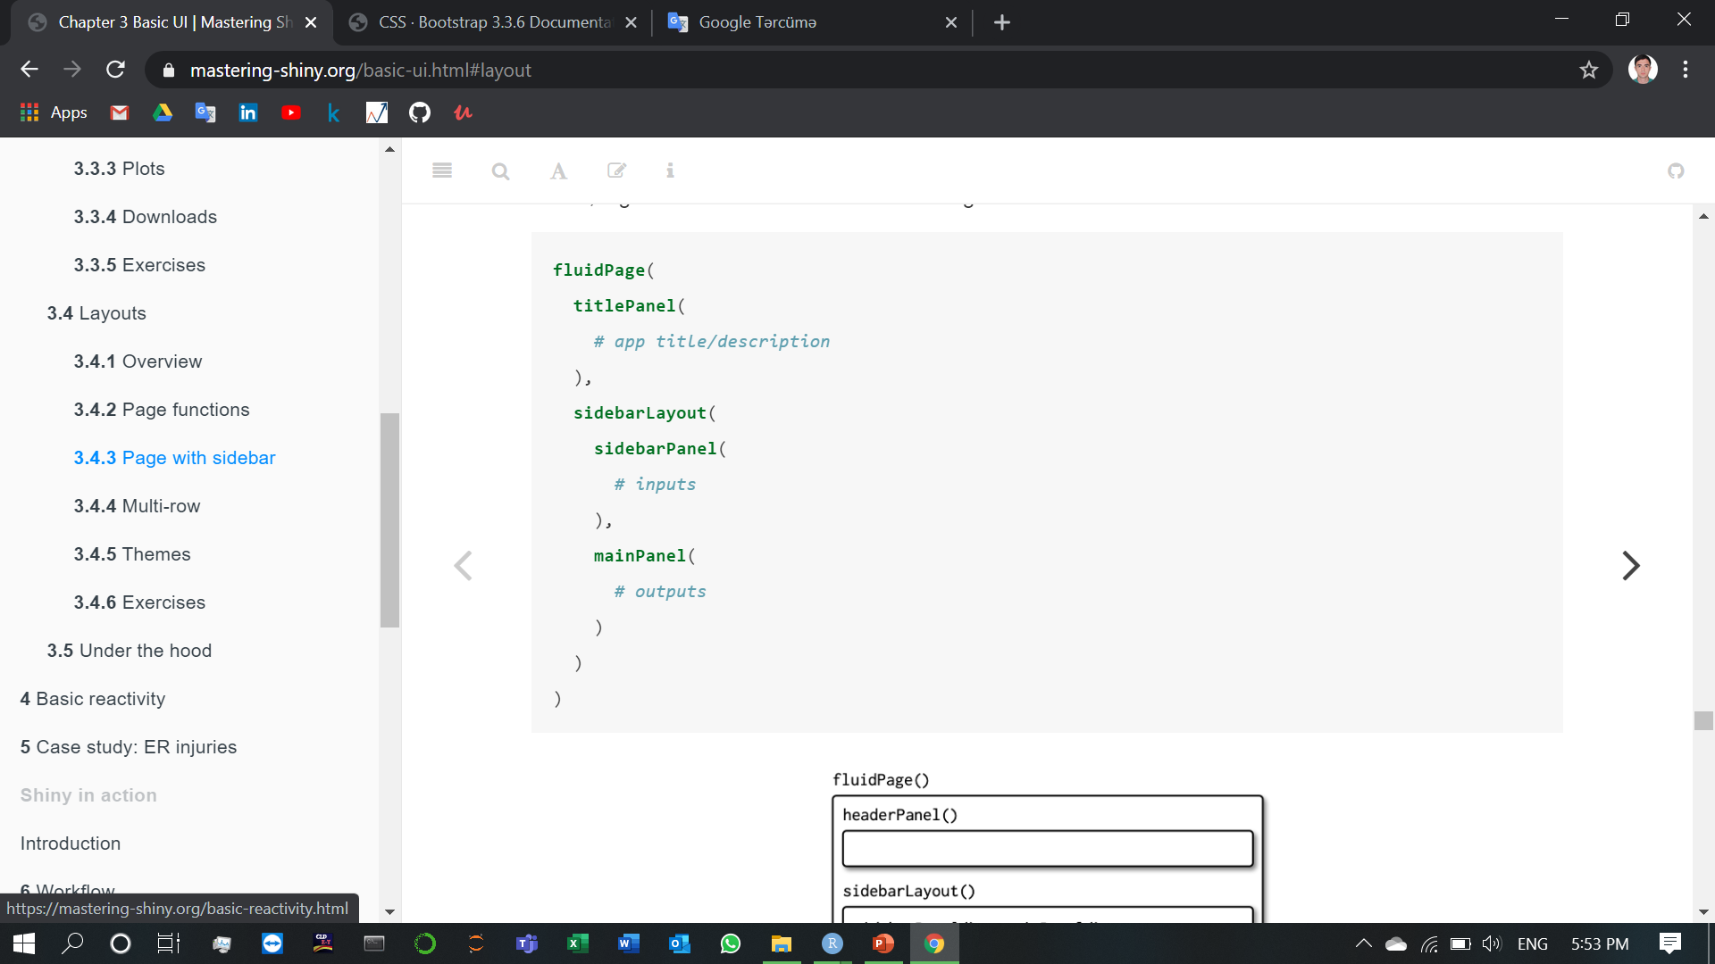
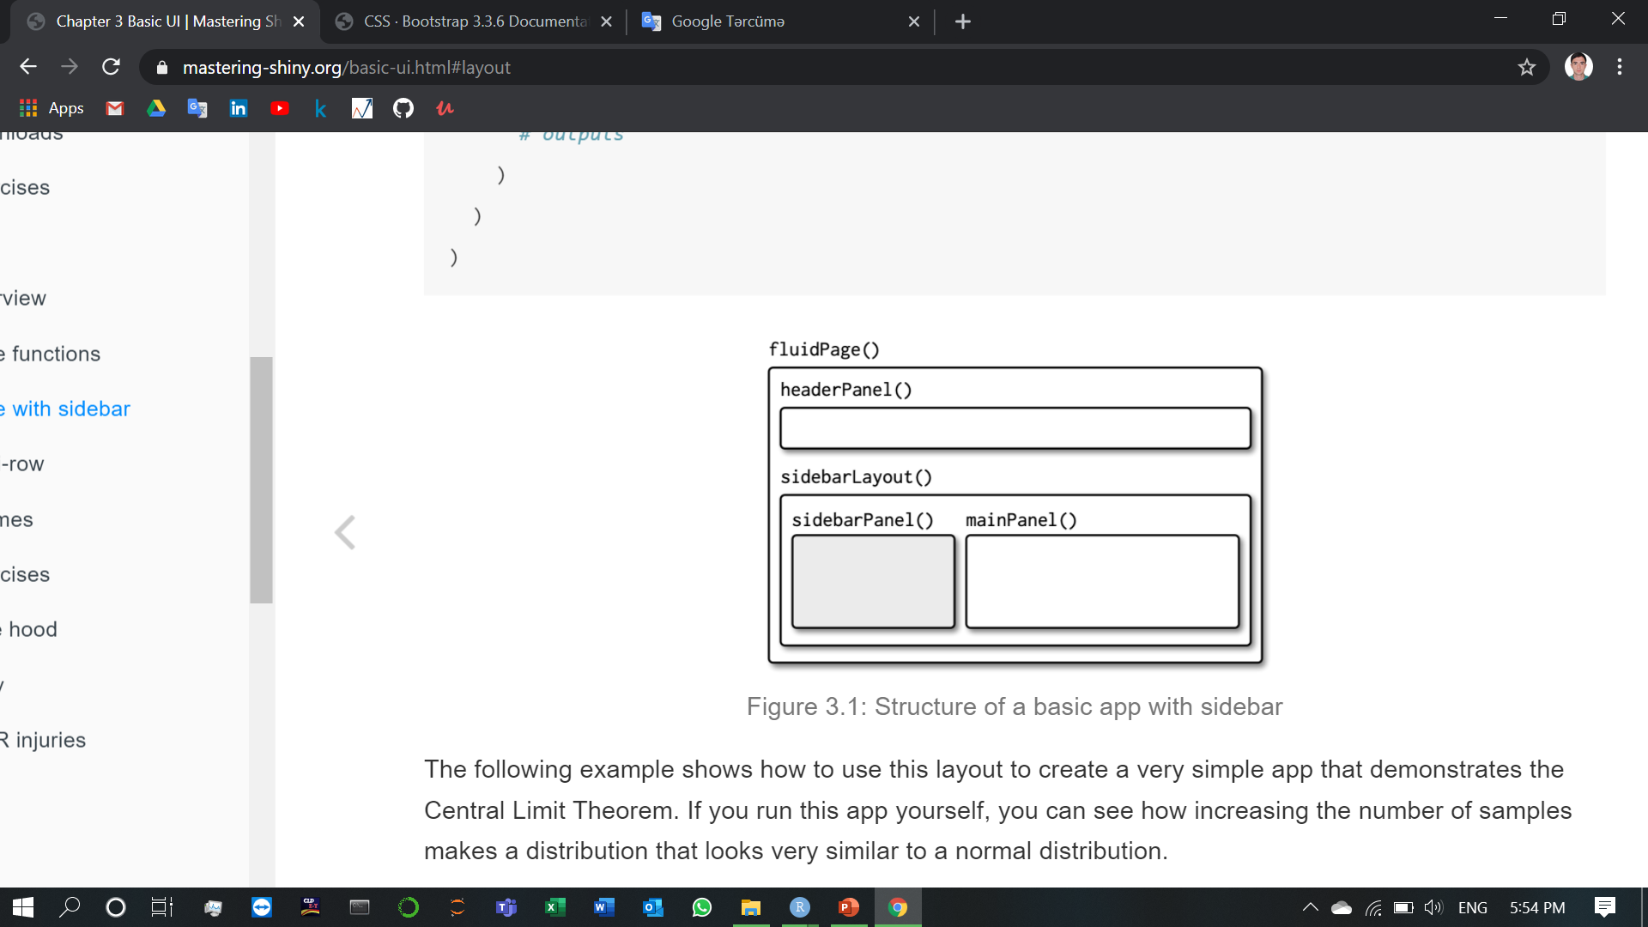
2.3) Outputs (1.Page with sidebar)
The following example shows how to use this layout to create a very simple app that demonstrates the Central Limit Theorem. If you run this app yourself, you can see how increasing the number of samples makes a distribution that looks very similar to a normal distribution.

Slide 22
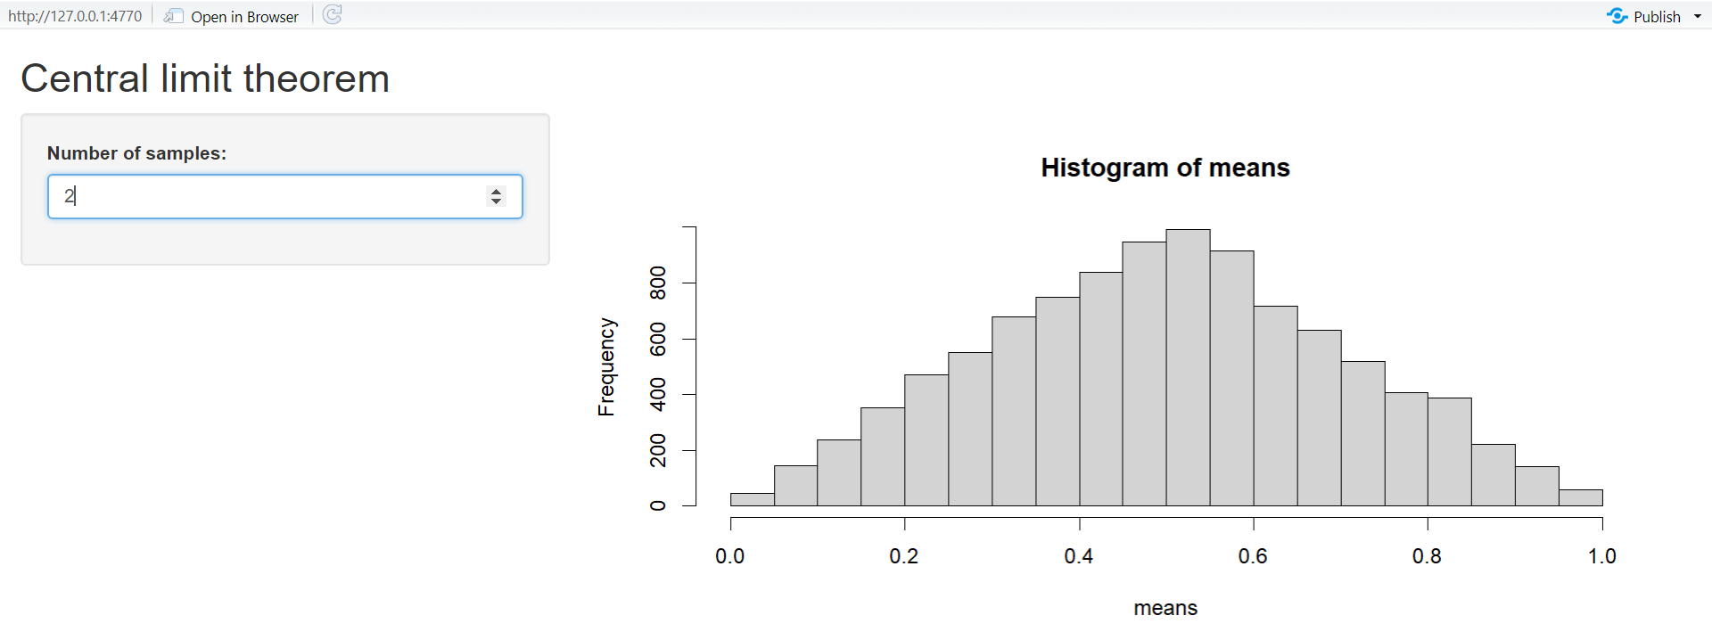

Slide 23
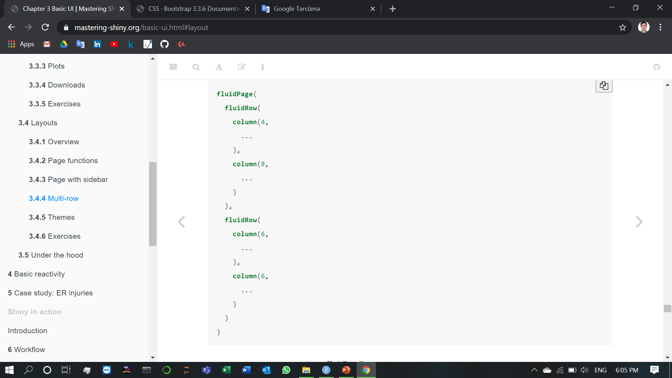
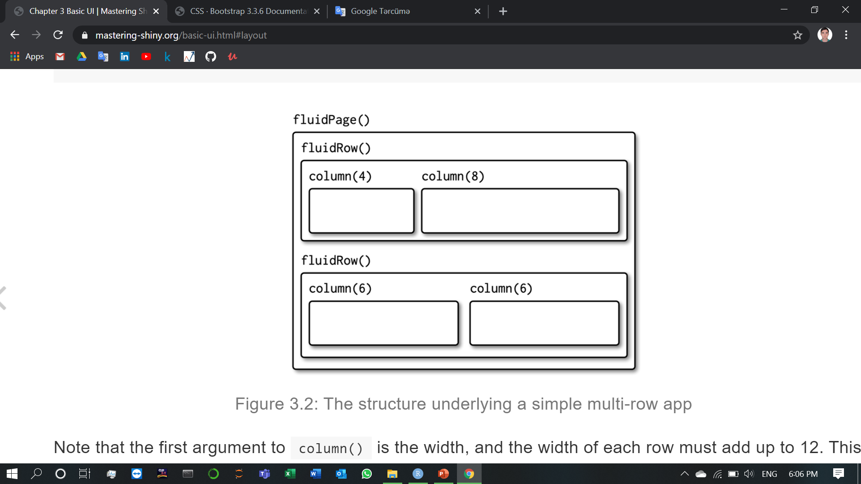
2.3) Outputs (2.Multi-row)
Note that the first argument to column() is the width, and the width of each row must add up to 12. This gives you substantial flexibility because you can easily create 2-, 3-, or 4-column layouts (more than that starts to get cramped), or use narrow columns to create spacers.

Slide 24
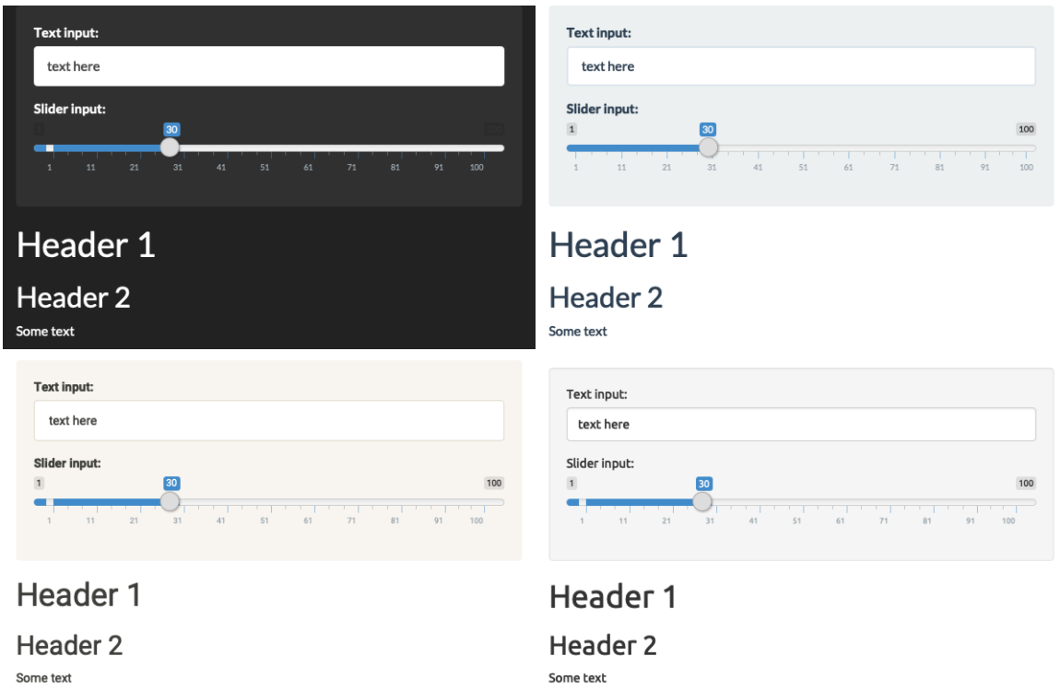
2.3) Outputs (3.Themes)
Creating a complete theme from scratch is a lot of work (but often worth it!), but you can get some easy wins by using the shinythemes package.
As you can see, theming your app is quite straightforward: you just need to use the theme argument to fluidPage(). To find out what themes are available, and what they look like, take a look at the Shiny theme selector app at https://shiny.rstudio.com/gallery/shiny-theme-selector.html. You might also want to take a look at the fresh (https://dreamrs.github.io/fresh/) package, which provides even more themes.

Slide 25
3)Basic reactivity
In the previous chapter, we talked about creating the user interfaces. Now we’ll move on to discuss the server side of Shiny, where you use R code at runtime to make your user interface come to life.
In Shiny, you express your server logic using reactive programming. Reactive programming is an elegant and powerful programming paradigm, but it can be disorienting at first because it’s a very different paradigm to writing a script. The key idea of reactive programming is to specify a graph of dependencies so that when an input changes, all related outputs are automatically updated. This makes the flow of an app considerably simpler, but it takes a while to get your head around how it all fits together.
This chapter will provide a gentle introduction to reactive programming, teaching you the basics of the most basic reactive constructs you’ll use in Shiny apps. We’ll start with a survey of the server function, discussing in more detail how the input and output arguments work. Next we’ll review the simplest form of reactivity (where inputs are directly connected to outputs), and then discuss how reactive expressions allow you to eliminate duplicated work. We’ll finish by reviewing some common roadblocks encountered by newer Shiny users.

Slide 26
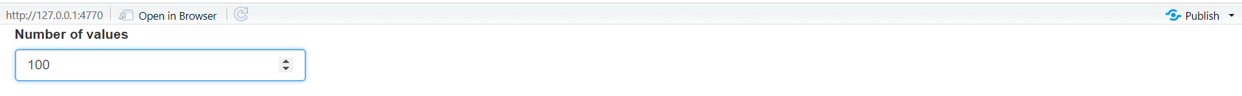
3.1) The server function (1.Input)
The input argument is a list-like object that contains all the input data sent from the browser, named according to the input ID. For example, if your UI contains a numeric input control with an input ID of count.
Then you can access the value of that input with input$count. It will initially contain the value 100, and it will be automatically updated as the user changes the value in the browser.

Slide 27
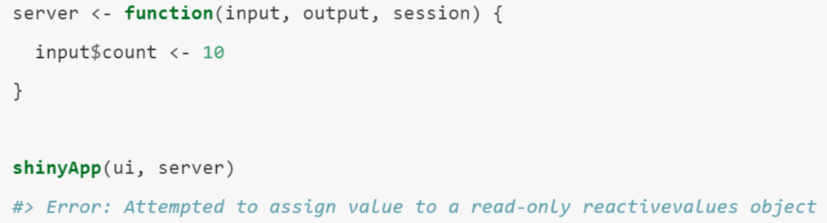
Unlike a typical list, input objects are read-only. If you attempt to modify an input inside the server function, you’ll get an error.
This error occurs because input reflects what’s happening in the browser, and the browser is Shiny’s “single source of truth”. If you could modify the value in R, you could introduce inconsistencies, where the input slider said one thing in the browser, and input$count said something different in R. That would make programming challenging!

Slide 28

3.1) The server function (2.Output)
output is very similar to input: it’s also a list-like object named according to the output ID. The main difference is that you use it for sending output instead of receiving input. You always use the output object in concert with a render function.
(Note that the ID is quoted in the UI, but not in the server.)
The render function does two things:
It sets up a special reactive context that automatically tracks what inputs the output uses.
It converts the output of your R code into HTML suitable for display on a web page.

Slide 29
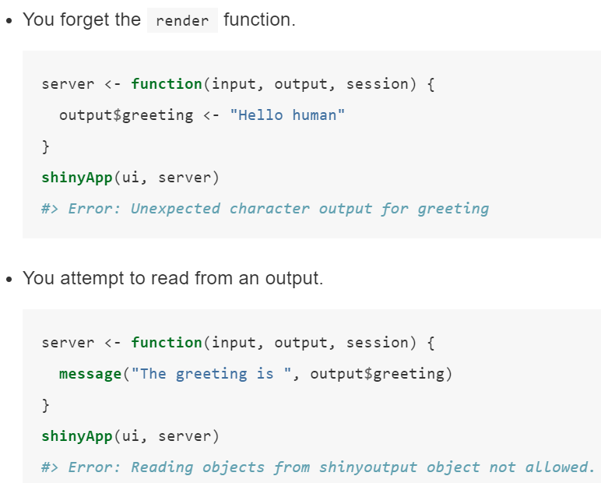
Like the input, the output is picky about how you use it. You’ll get an error if:

Slide 30
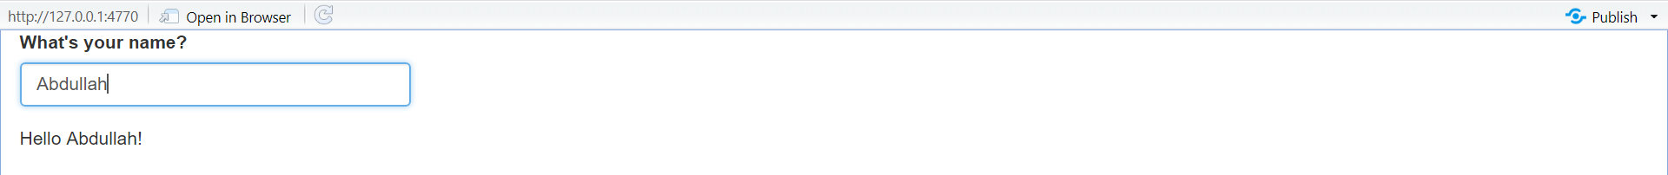
3.2) Reactive programming
It’s hard to show exactly how this works in a book, but if you run the app, and type in the name box, you’ll notice that the greeting updates automatically as you type.

Slide 31
3.3) Reactive expressions
We’ve quickly skimmed over reactive expressions a couple of times, so you’re hopefully getting a sense for what they might do. Now we’ll dive into more of the details, and show why they are so important when constructing real apps.
Reactive expressions are important for two reasons:
They give Shiny more information so that it can do less recomputation when inputs change, making apps more efficient.
They make it easier for humans to understand the app by simplifying the reactive graph.
Reactive expressions have a flavour of both inputs and outputs:
Like inputs, you can use the results of a reactive expression in an output.
Like outputs, reactive expressions depend on inputs and automatically know when they need updating.

Slide 32
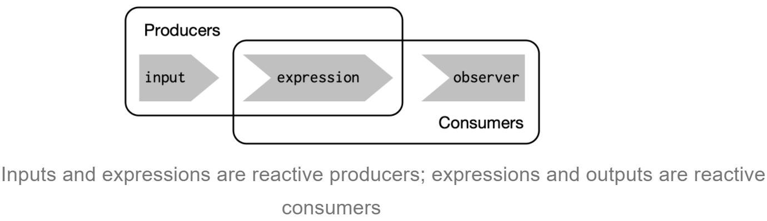
Because of this duality, some functions work with either reactive inputs or expressions, and some functions work with either reactive expressions or reactive outputs. We’ll use producers to refer to either reactive inputs or expressions, and consumers to refer to either reactive expressions or outputs. Following figure shows this relationship with a Venn diagram.
We’re going to need a more complex app to see the benefits of using reactive expressions. First, we’ll set the stage by defining some regular R functions that we’ll use to power our app.

Slide 33
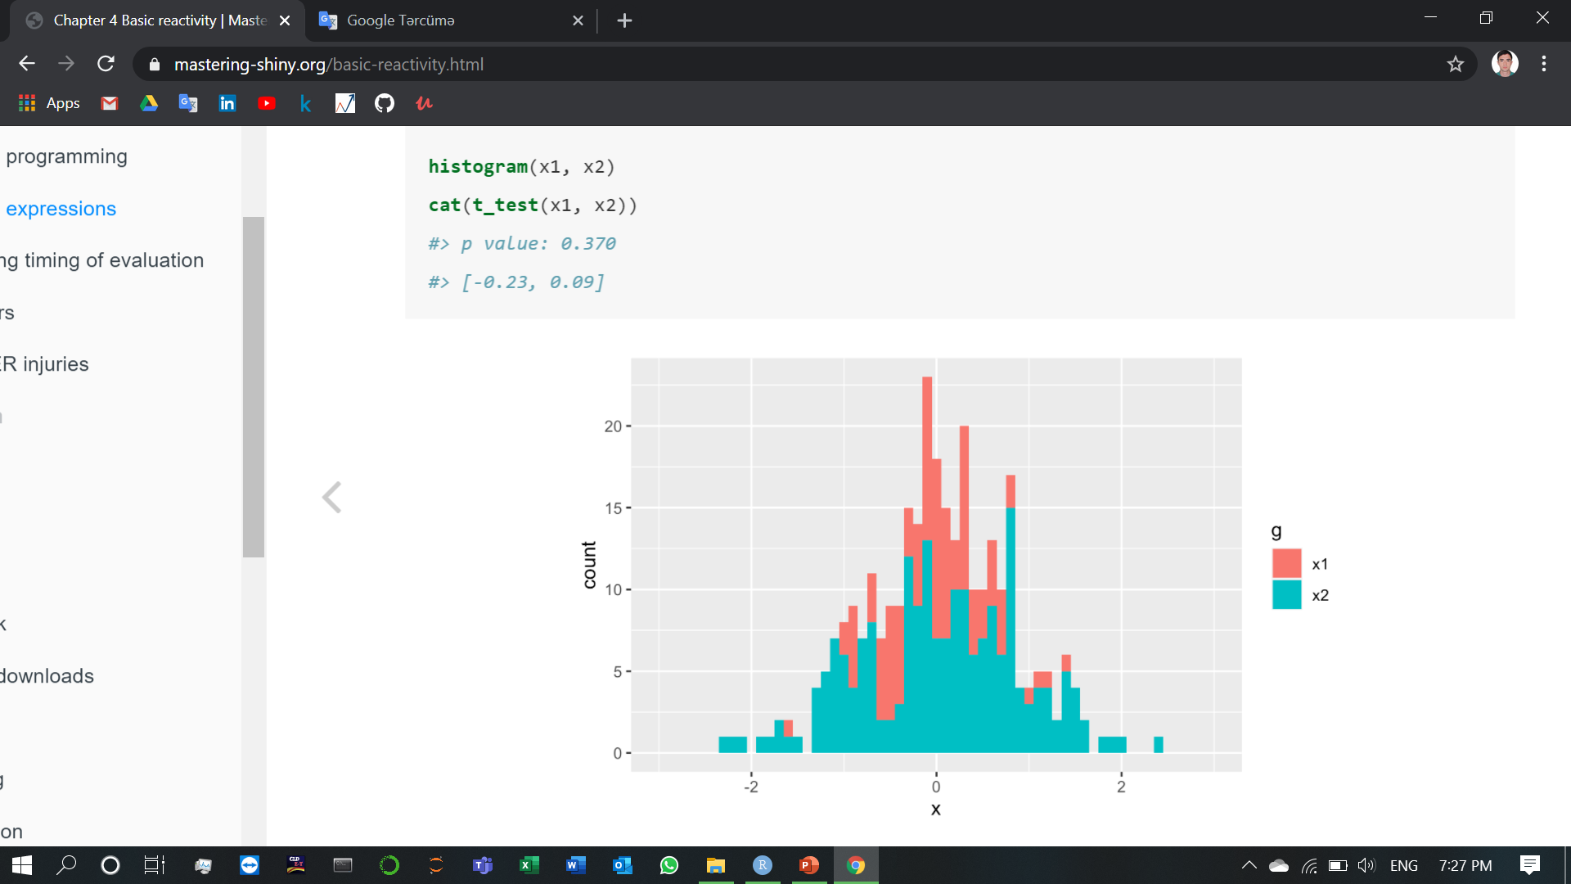
3.3) Reactive expressions (1.The motivation)
Imagine I want to compare two simulated datasets with a plot and a hypothesis test. I’ve done a little experimentation and come up with the functions below: histogram() visualises the two distributions with a histogram, and t_test() uses a t-test to compare means and summarises the results with a string:
If I have some simulated data, I can use these functions to compare two variables:
In a real analysis, you probably would’ve done a bunch of exploration before you ended up with these functions. I’ve skipped that exploration here so we can get to the app as quickly as possible. But extracting imperative code out into regular functions is an important technique for all Shiny apps: the more code you can extract out of your app, the easier it will be to understand. This is good software engineering because it helps isolate concerns: the functions outside of the app focus on the computation so that the code inside of the app can focus on responding to user actions.

Slide 34
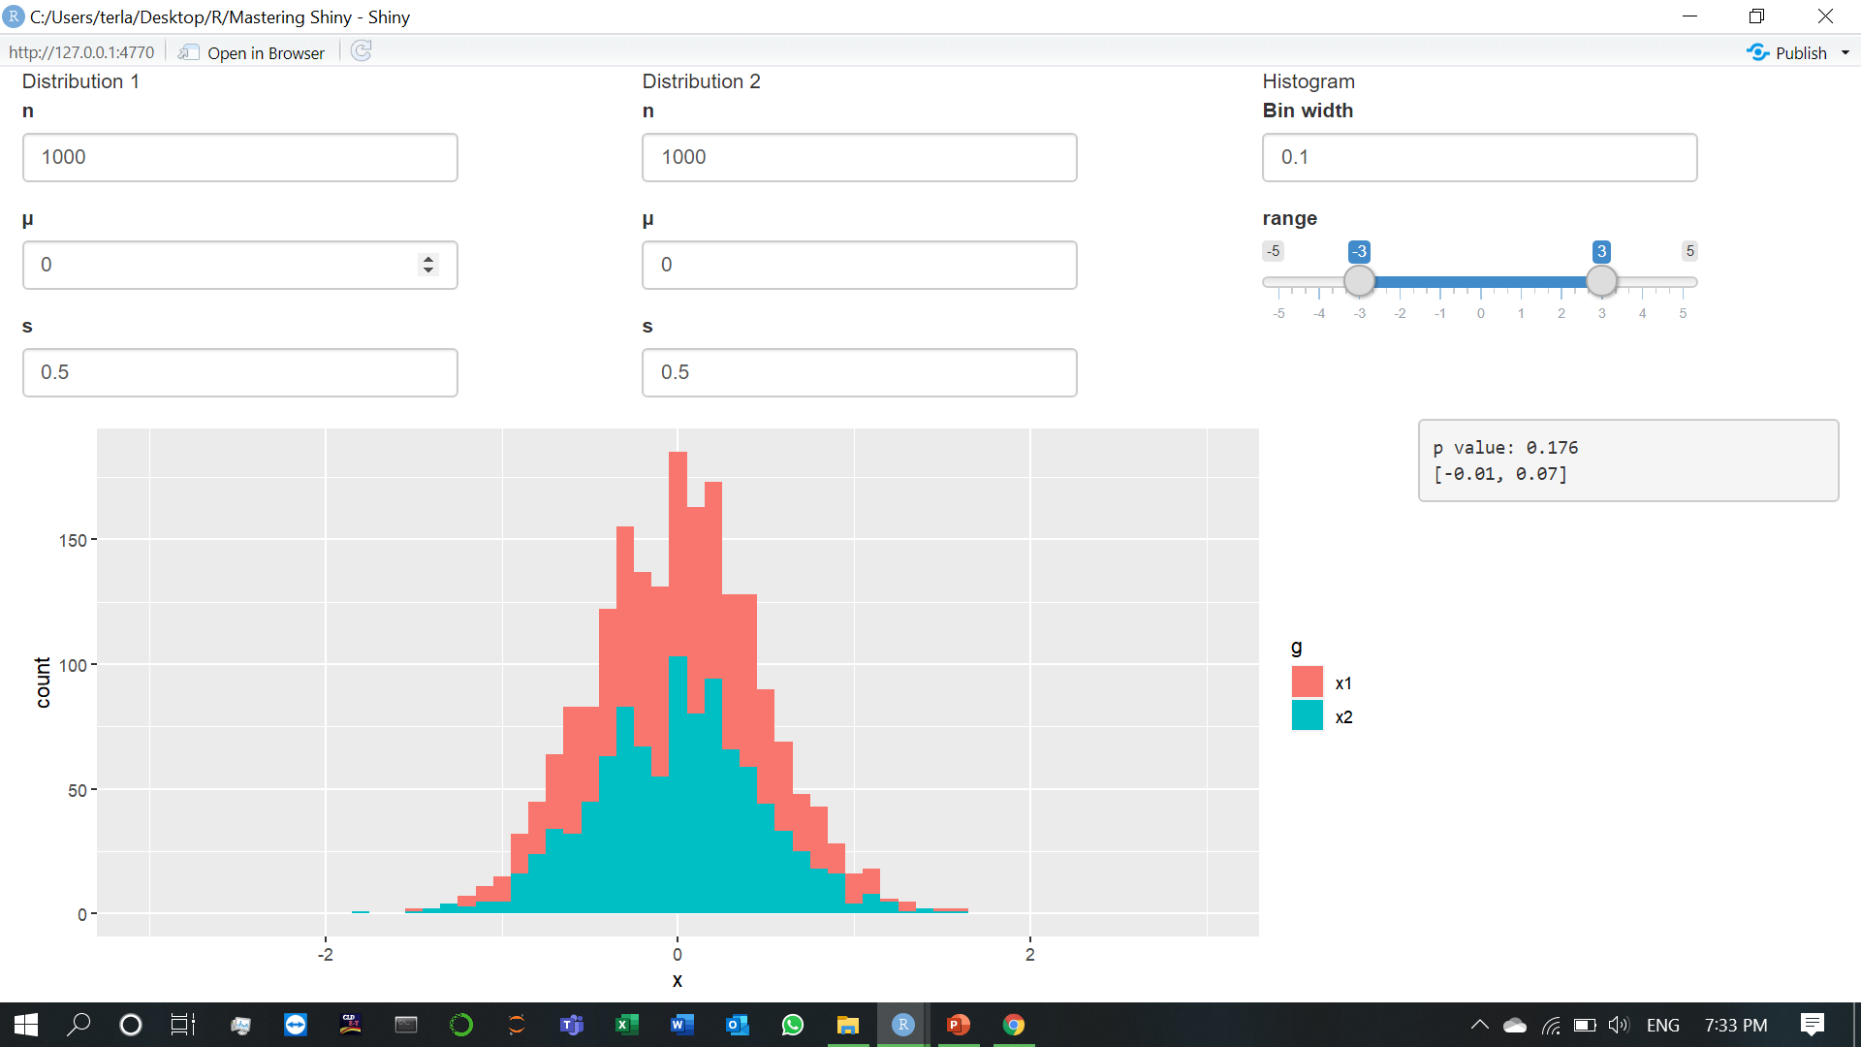
3.3) Reactive expressions (2.The app)

Slide 35
I’d like to use these two tools to quickly explore a bunch of simulations. A Shiny app is a great way to do this because it lets you avoid tediously modifying and re-running R code.
Let’s start with the UI. The first row has three columns for input controls (distribution 1, distribution 2, and plot controls). The second row has a wide column for the plot, and a narrow column for the hypothesis test.
The server function combines calls to histogram() and t_test() functions after drawing from the specified distributions .

Slide 36
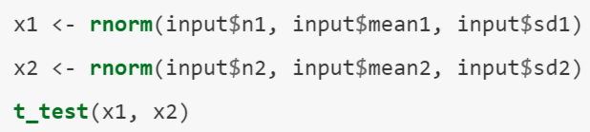
3.3) Reactive expressions (3.The reactive graph)
Let’s start by drawing the reactive graph of this app. Shiny is smart enough to update an output only when the inputs it refers to change; it’s not smart enough to only selectively run pieces of code inside an output. In other words, outputs are atomic: they’re either executed or not as a whole.
For example, take this snippet from the server:

Slide 37
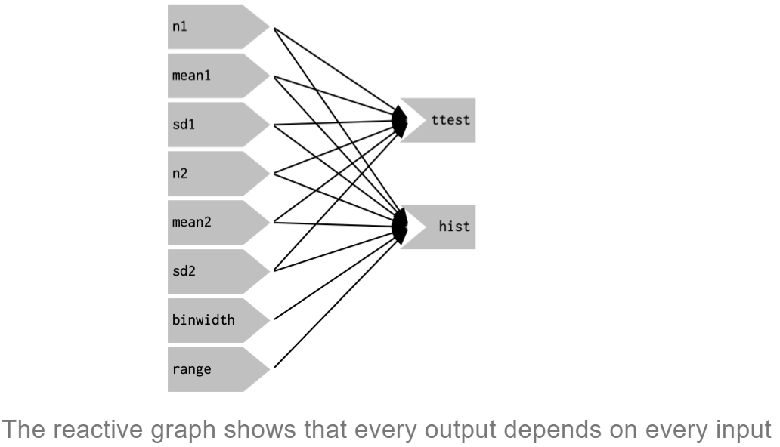
As a human reading this code you can tell that we only need to update x1 when n1, mean1, or sd1 changes, and we only need to update x2 when n2, mean2, or sd2 changes. Shiny, however, only looks at the output as a whole, so it will update both x1 and x2 every time one of n1, mean1, sd1, n2, mean2, or sd2 changes. This leads to the reactive graph shown Following figure:

Slide 38
You’ll notice that the graph is very dense: almost every input is connected directly to every output. This creates two problems:
The app is hard to understand because there are so many connections. There are no pieces of the app that you can pull out and analyse in isolation.
The app is inefficient because it does more work than necessary. For example, if you change the breaks of the plot, the data is recalculated; if you change the value of n1, x2 is updated (in two places!).
There’s one other major flaw in the app: the histogram and t-test use separate random draws. This is rather misleading, as you’d expect them to be working on the same underlying data.
Fortunately, we can fix all these problems by using reactive expressions to pull out repeated computation.

Slide 39
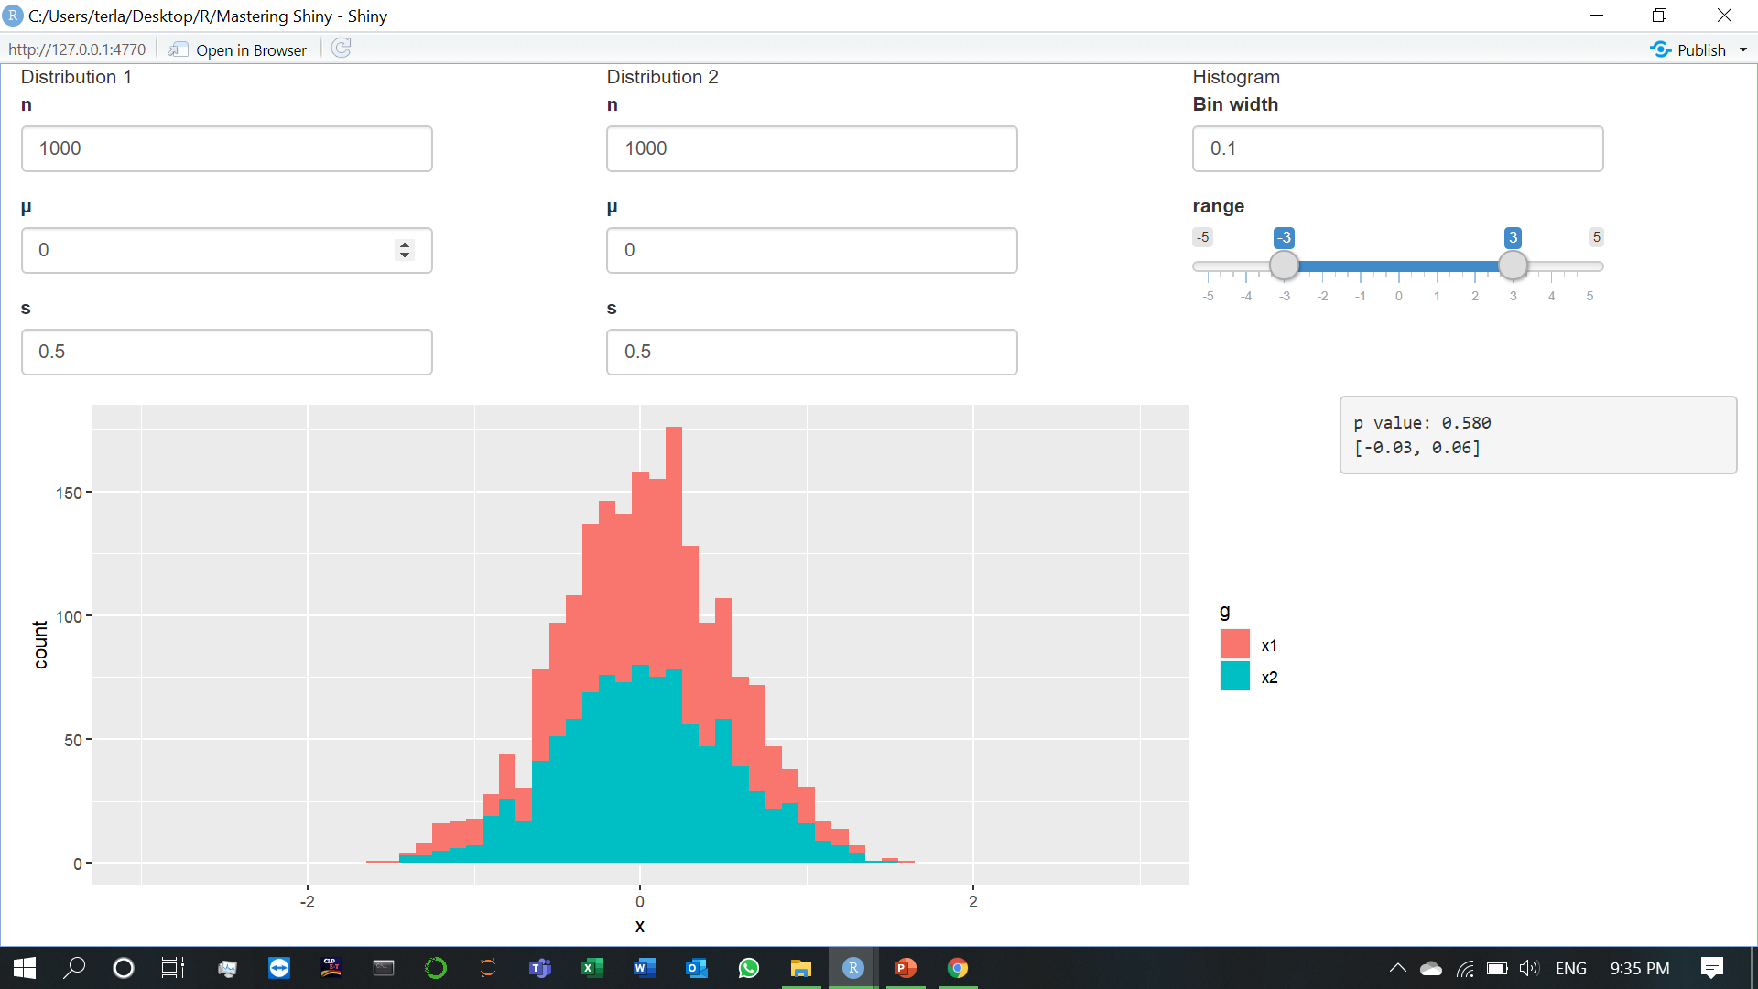
3.3) Reactive expressions (4.Simplifying the graph)

Slide 40
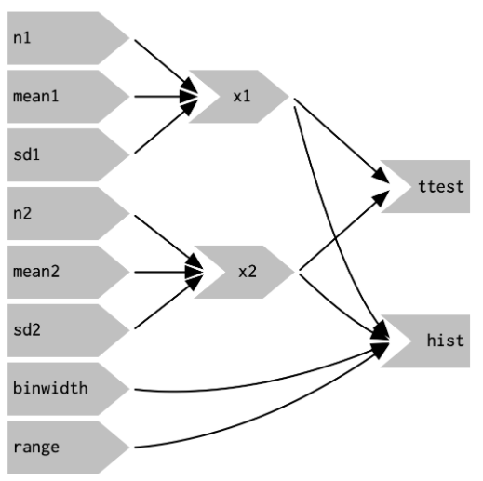
In the server function now we refactor the existing code to pull out the repeated code into two new reactive expressions, x1 and x2, which simulate the data from the two distributions. To create a reactive expression, we call reactive() and assign the results to a variable. To later use the expression, we call the variable like it’s a function.
This transformation yields the substantially simpler graph shown in Following figure. This simpler graph makes it easier to understand the app because you can understand connected components in isolation; the values of the distribution parameters only affect the output via x1 and x2. This rewrite also makes the app much more efficient since it does much less computation. Now, when you change the binwidth or range, only the plot changes, not the underlying data.

Slide 41
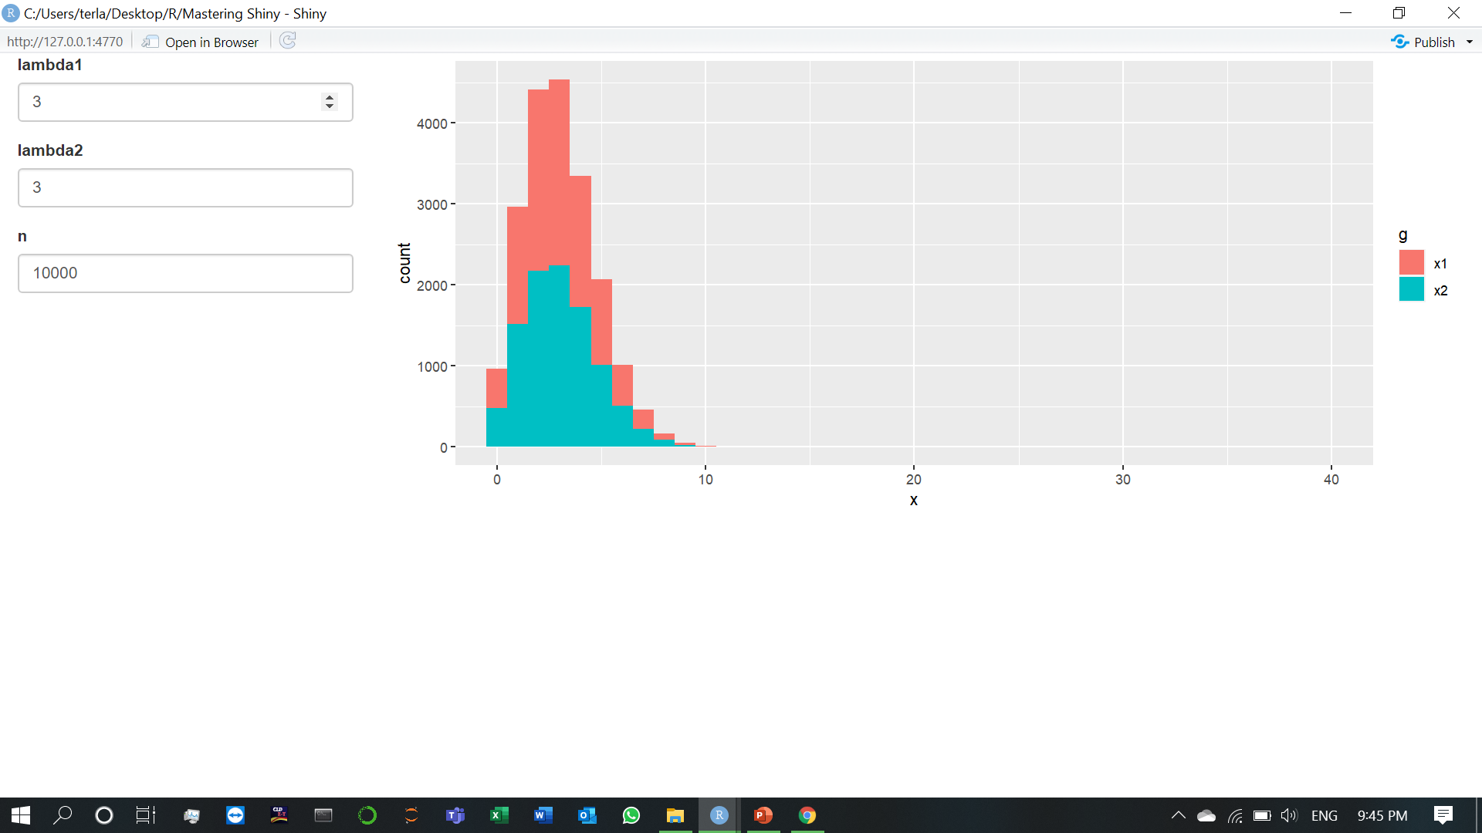
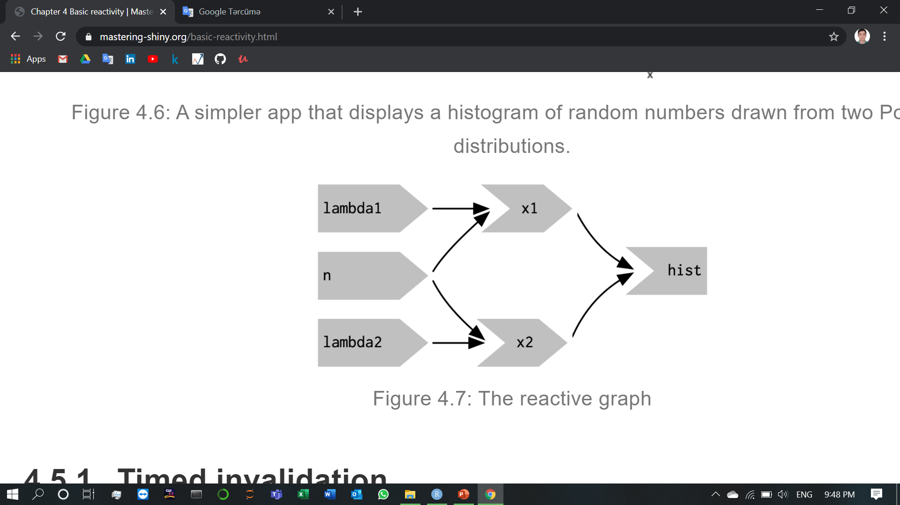
3.4) Controlling timing of evaluation
To explore the basic ideas, I’m going to simplify my simulation app. I’ll use a distribution with only one parameter, and force both samples to share the same n. I’ll also remove the plot controls.

Slide 42
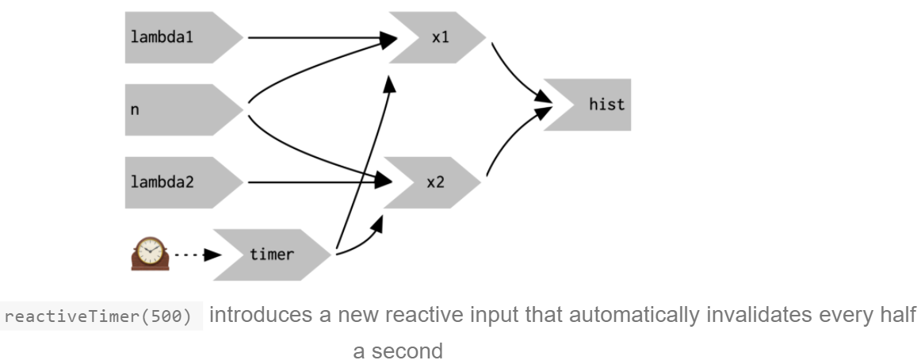
3.4) Controlling timing of evaluation (1.Timed invalidation)
Imagine you wanted to reinforce the fact that this is for simulated data by constantly resimulating the data, so that you see an animation rather than a static plot. We can increase the frequency of updates with a new function: reactiveTimer().
reactiveTimer() is a reactive expression that has a dependency on a hidden input: the current time. You can use a reactiveTimer() when you want a reactive expression to invalidate itself more often than it otherwise would. For example, the following code uses an interval of 500 ms so that the plot will update twice a second. This is fast enough to remind you that you’re looking at a simulation, without dizzying you with rapid changes. This change yields the reactive graph shown in Following figure.
Note how we use timer() in the reactive expressions that compute x1() and x2(): we call it, but don’t use the value. This lets x1 and x2 take a reactive dependency on timer, without worrying about exactly what value it returns.

Slide 43
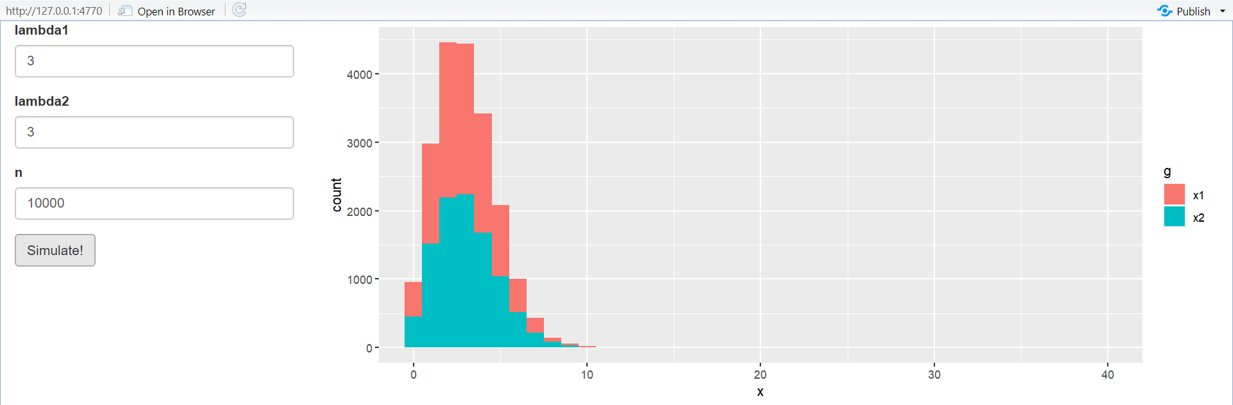
3.4) Controlling timing of evaluation (2.On click)
If this situation arises in your app, you might want to require the user to opt-in to performing the expensive calculation by requiring them to click a button. This is a great use case for an actionButton().

Slide 44
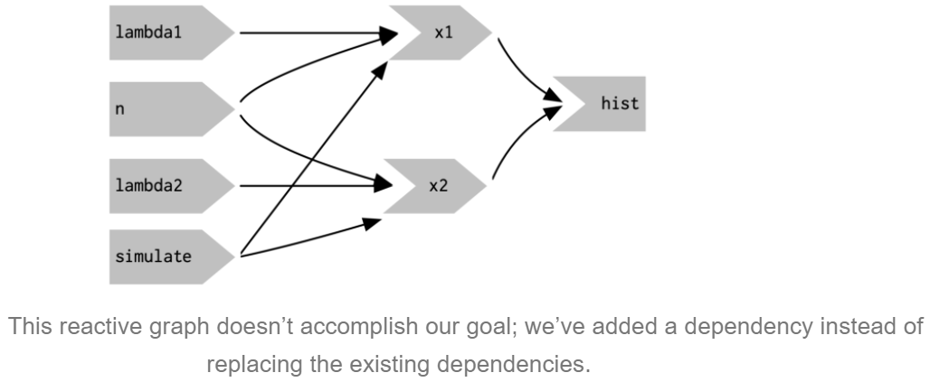
To use the action button we need to learn a new tool. To see why, let’s first tackle the problem using the same approach as above. As above, we refer to simulate without using its value to take a reactive dependency on it.
This doesn’t achieve our goal because it just introduces a new dependency: x1() and x2() will update when we click the simulate button, but they’ll also continue to update when lambda1, lambda2, or n change. We want to replace the existing dependencies, not add to them.

Slide 45
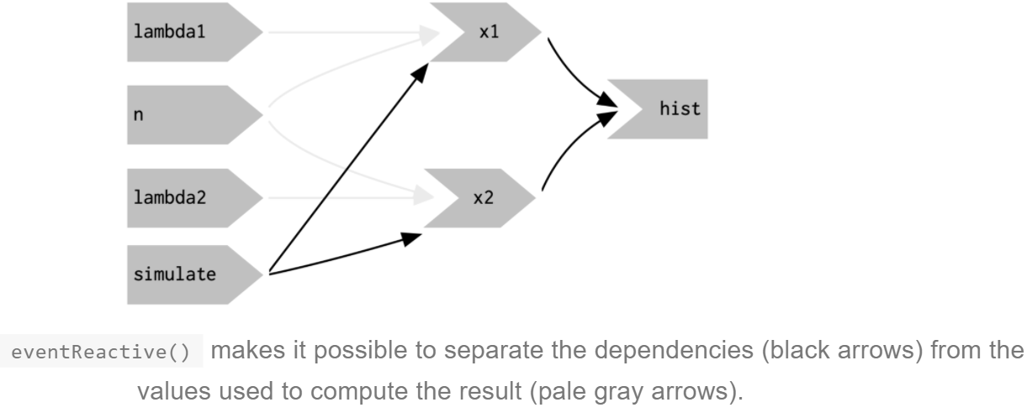
To solve this problem we need a new tool: a way to use input values without taking a reactive dependency on them. We need eventReactive(), which has two arguments: the first argument specifies what to take a dependency on, and the second argument specifies what to compute. That allows this app to only compute x1() and x2() when simulate is clicked.
Following figure shows the new reactive graph. Note that, as desired, x1 and x2 no longer have a reactive dependency on lambda1, lambda2, and n: changing their values will not trigger computation. I left the arrows in very pale grey just to remind you that x1 and x2 continue to use the values, but no longer take a reactive dependency on them.

Slide 46
4)Graphics
We talked briefly about renderPlot() in Chapter 2; it’s a powerful tool for displaying graphics in your app. This chapter will show you how to use it to its full extent to create interactive plots, plots that respond to mouse events. You’ll also learn about two important related functions: renderCachedPlot(), which speeds up your app by caching frequently used plots, and renderImage(), which allows you to display existing images.

Slide 47
4.1) Ineractivity
One of the coolest things about plotOutput() is that as well as being an output that displays plots, it can also be an input that responds to pointer events. That allows you to create interactive graphics where the user interacts directly with the data on the plot. Interactive graphics are a powerful tool, with a wide range of applications.
A plot can respond to four different mouse19 events: click, dblClick (double click), hover (when the mouse stays in the same place for a little while), and brush (a rectangular selection tool). To turn these events into Shiny inputs, you supply a string to the corresponding plotOutput() argument, e.g. plotOutput("plot", click = "plot_click"). This creates an input$plot_click that you can use to handle mouse clicks on the plot.

Slide 48
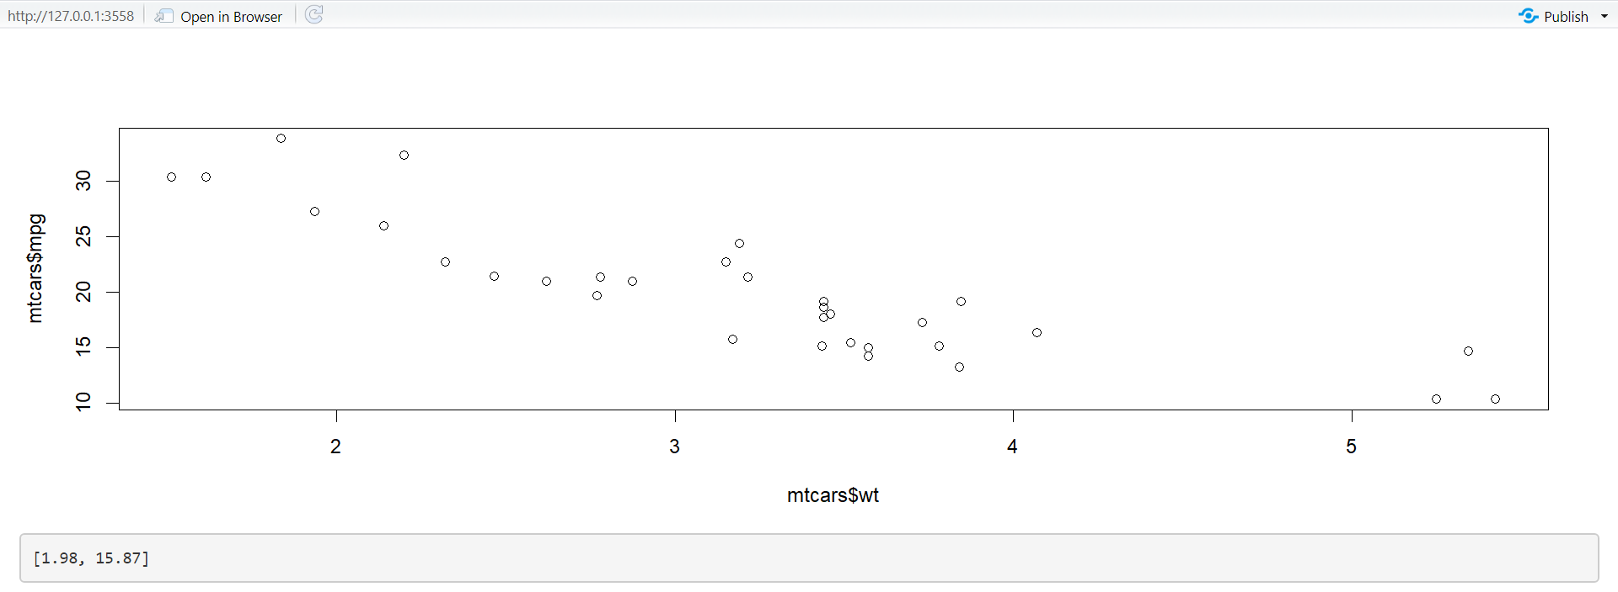
4.1) Ineractivity (1.Basics)
Here’s a very simple example of handling a mouse click. We register the plot_click input, and then use that to update an output with the coordinates of the mouse click.
(Note the use of req(), to make sure the app doesn’t do anything before the first click, and that the coordinates are in terms of the underlying wt and mpg variables.)

Slide 49
4.1) Ineractivity (2. Clicking)
The point events return a relatively rich list containing a lot of information. The most important components are x and y, which give the location of the event in data coordinates. But I’m not going to talk about this data structure, since you’ll only need in relatively rare situations (If you do want the details, use this app in the Shiny gallery). Instead, you’ll use the nearPoints() helper, which finds data points near the event, taking care of a bunch of fiddly details.
Here’s a simple example of nearPoints() in action, showing a table of data about the points near the event.

Slide 50
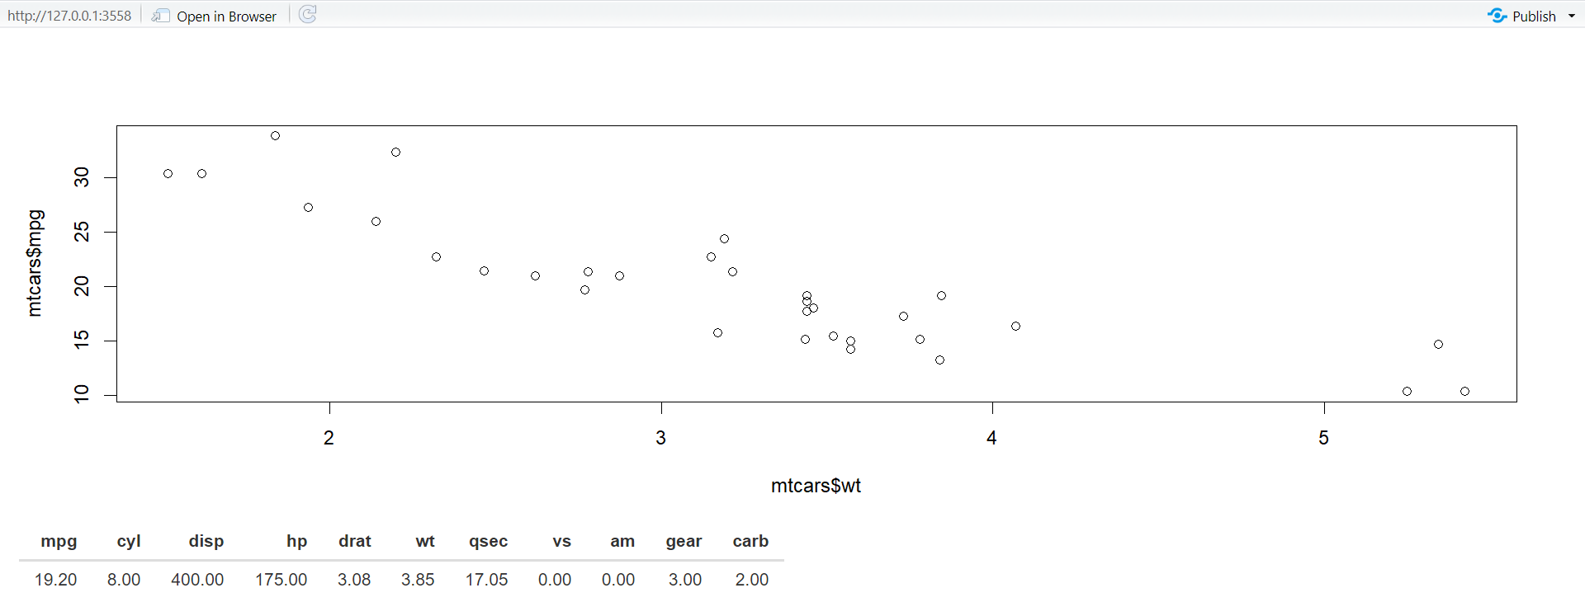
Here we give nearPoints() four arguments: the data frame that underlies the plot, the input event, and the names of the variables on the axes. If you use ggplot2, you only need to provide the first two arguments since xvar and yvar can be automatically imputed from the plot data structure. For that reason, I’ll use ggplot2 throughout the rest of the chapter. Here’s that previous example reimplemented with ggplot2:

Slide 51
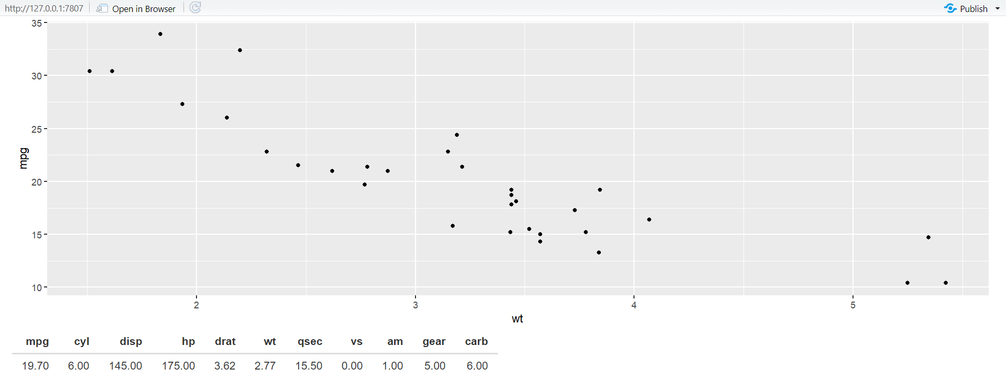
Another way to use nearPoints() is with allRows = TRUE and addDist = TRUE. That will return the original data frame with two new columns:
dist_ gives the distance between the row and the event (in pixels).
selected_ says whether or not it should be selected (i.e. the logical vector that’s usually returned).

Slide 52
4.1) Ineractivity (3.Brushing)
Another way of selecting points on a plot is to use a brush, a rectangular selection defined by four edges. In Shiny, using a brush is straightforward once you’ve mastered click and nearPoints(): you just switch to brush argument and the brushedPoints() helper.
Here’s another simple example that shows which points have been selected by the brush:

Slide 53
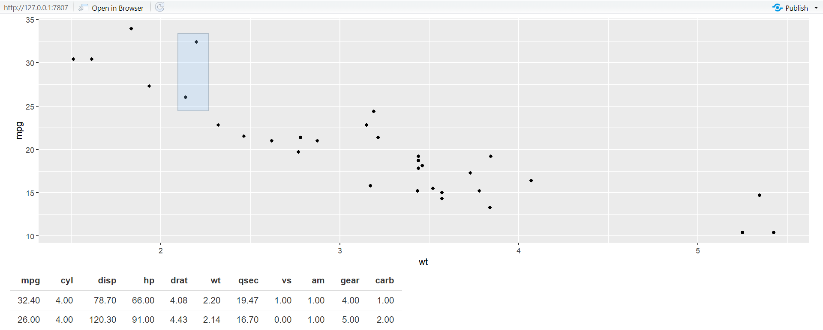
Use brushOpts() to control the colour (fill and stroke), or restrict brushing to a single dimension with direction = "x" or "y" (useful, e.g., for brushing time series).

Slide 54
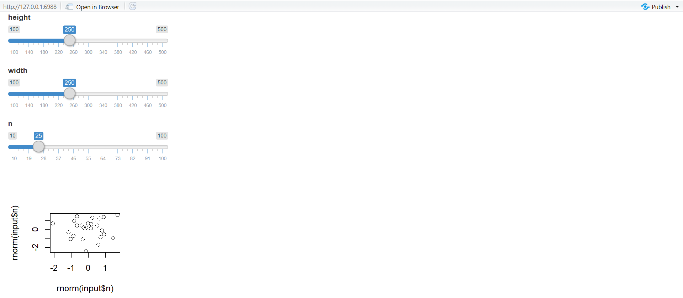
4.2) Dynamic height and width
The rest of this chapter is less exciting than interactive graphics, but contains material that’s important to cover somewhere.
First, you can make plot size reactive, so it resizes in response to user actions. To do this, supply zero-argument functions to the width and height arguments. These functions should have no argument and return the desired size in pixels. They are evaluated in a reactive environment so that you can make the size of your plot dynamic.
The following app illustrates the basic idea. It provides two sliders that directly control the size of the plot.

